Slide 1

We are Looking for People Who are Looking.
Are YOU Looking?

Slide 2

Would you be surprised to know that you are already doing what we do everyday,
BUT you are not getting paid for it?
Let’s Learn How to Get Paid!

Slide 3

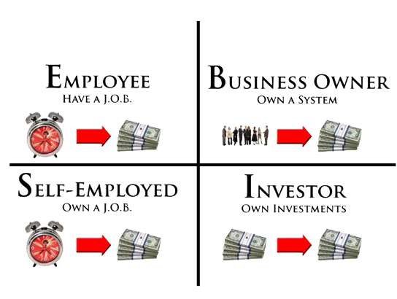

4 WAYS TO
PRODUCE INCOME
95% US Population
5% Wealth
5% US Population
95% Wealth

Slide 4



Dreams
$$
Notes:
Remember when you were young and you had dreams of what you life was going to be like
For most that ended when we got our first paycheck and most people are not living their dream
Instead they are living to survive
You either have to shrink your dreams to fit you income or grow your income to fit your dreams

Slide 5

45 YEAR PLAN
Income
Time

Slide 6


The Secret of Success
A----------Vehicle---------B
What is YOUR Prime Motivating Factor?

Slide 7



Looking Zone

Slide 8


TRENDING TODAY
HEALTH and CROSS BORDER E-COMMERCE

Slide 9

Why THREE ?
1.Start your Own Business
2. Do not have to give up what you are doing
3. Does not cost a lot of money to start
4. You do not have to know anything about business as you will have a mentor/system
5. Unlimited Income Potential
6. Ongoing Income Potential

