Slide 1


Slide 2

The OPPORTUNITY
About THREE International
Our Foundation:
Founded Based on a Collaborative Effort From a Group of
Experienced International Business Builders.
  Headquartered in Lehi, Utah USA
  Launched on May 2023
  Currently Have Offices in Hong Kong and Indonesia

Slide 3


Slide 4


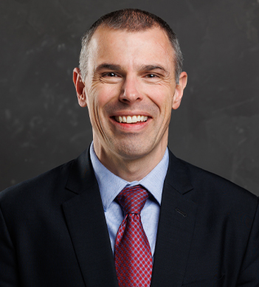
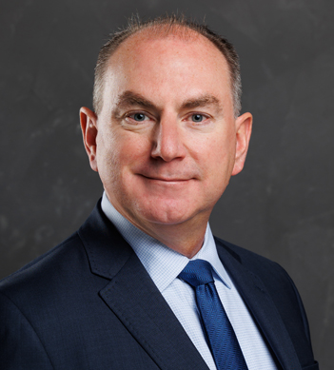
DANIEL PICOU
Founder & CEO
DR. DAN GUBLER
CHIEF SCIENTIFIC OFFICER
TROY MOHR
COO

Slide 5

Notes:
v

Slide 6


Slide 7
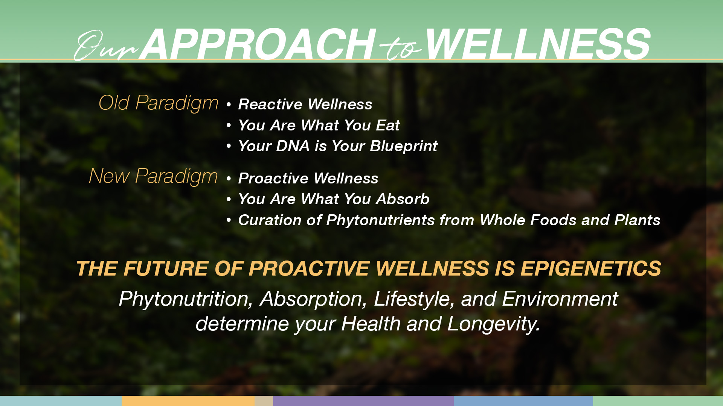

Slide 8
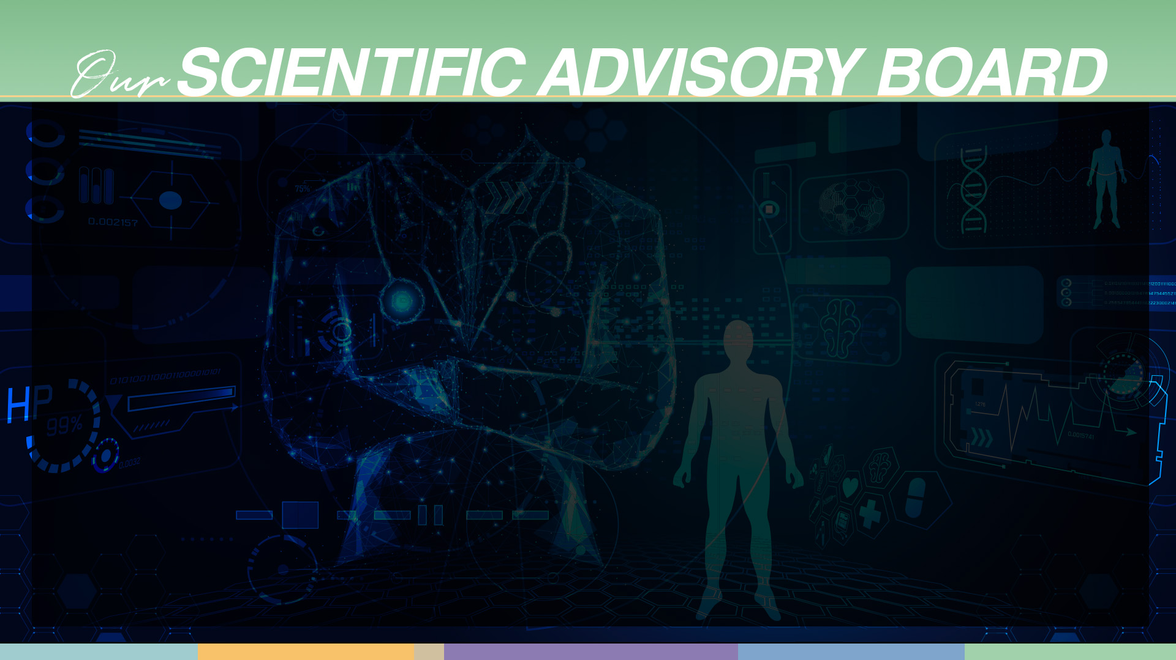
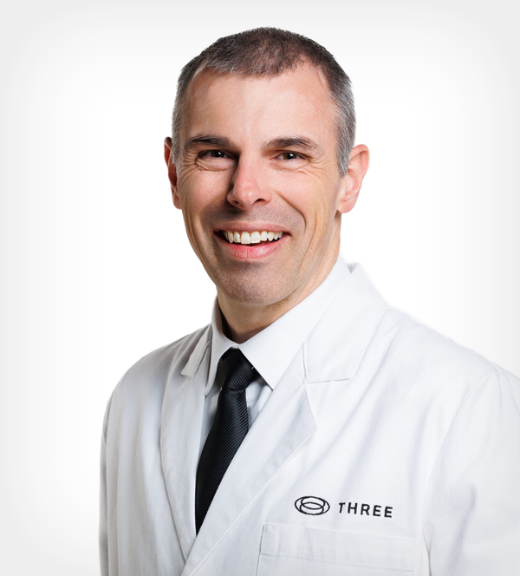
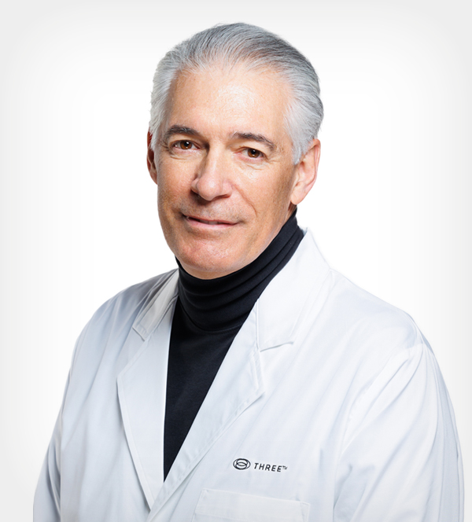






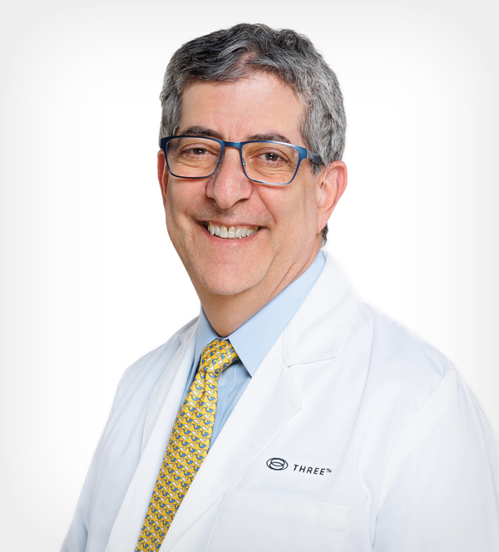
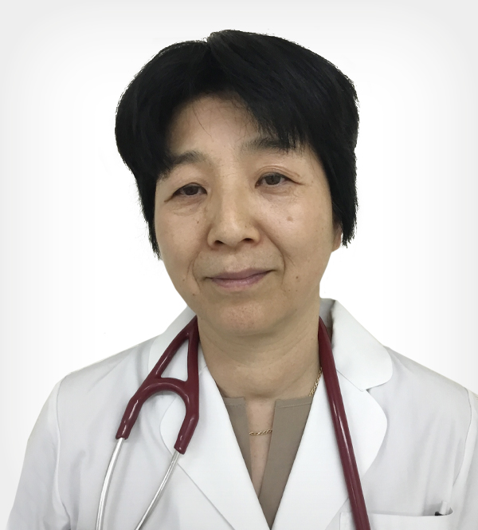
DR. DAN GUBLER
Ph.D. | Chief Scientific Officer
DR. TIMOTHY SCHNEIDER
MD | SAB Chair
DR. JAMES BAKER
DO, FACOI
DR. JESSICA BORDON
DPM, PA
DR. LANA GALICIA
MD
DR. CHARLES GREENE
MD, Ph.D.
DR. CATHERINE MADAFFARI
MD
PROFESSOR SASTIA PUTRI
Ph. D.
DR. STEPHEN SABO
MD
DR. NAOKO YOSHIMURA
MD

Slide 9
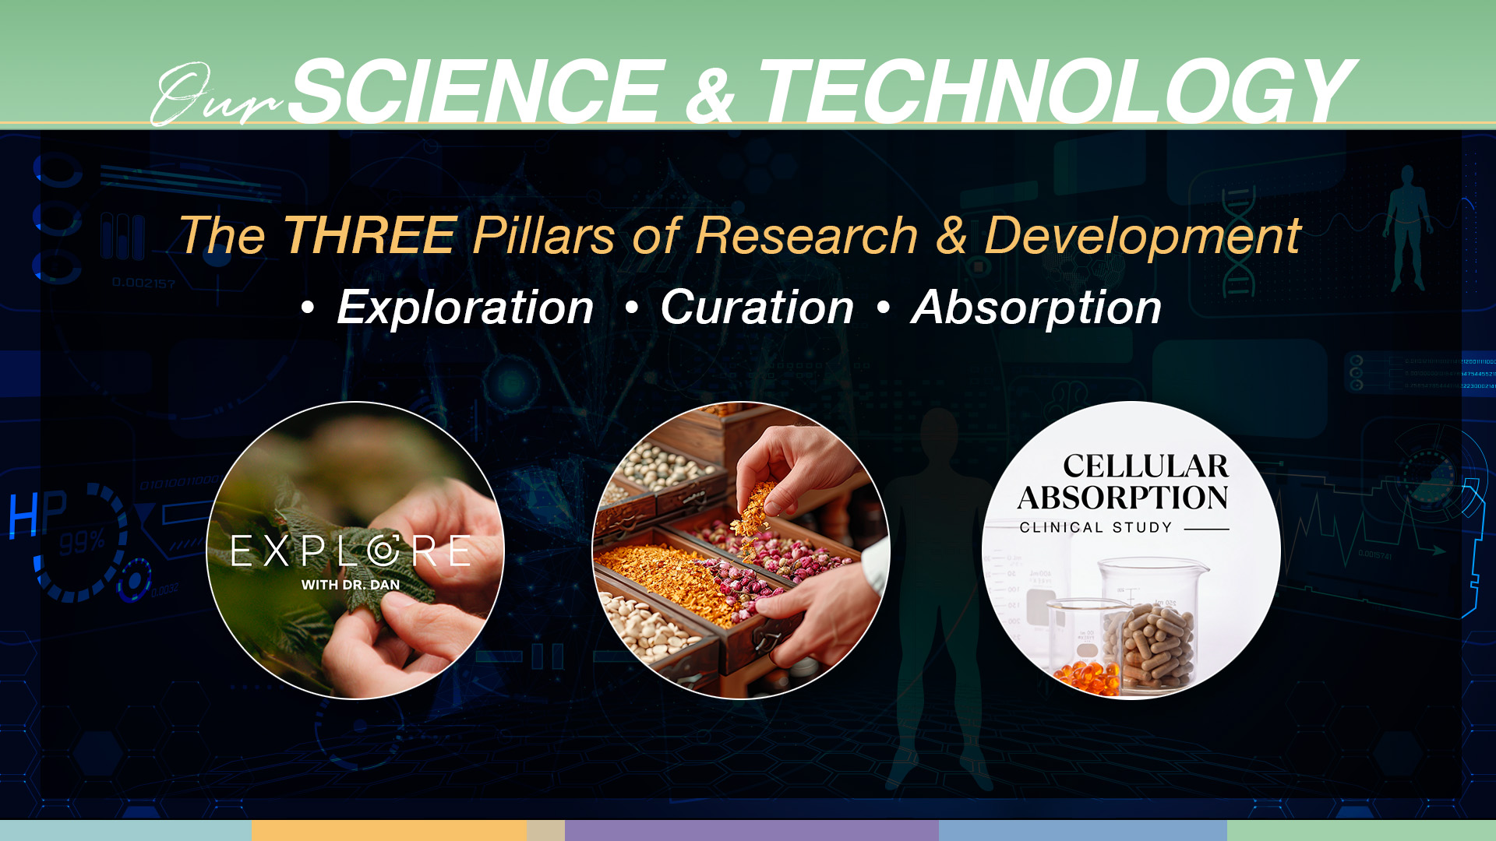
The THREE EDGE

Slide 10
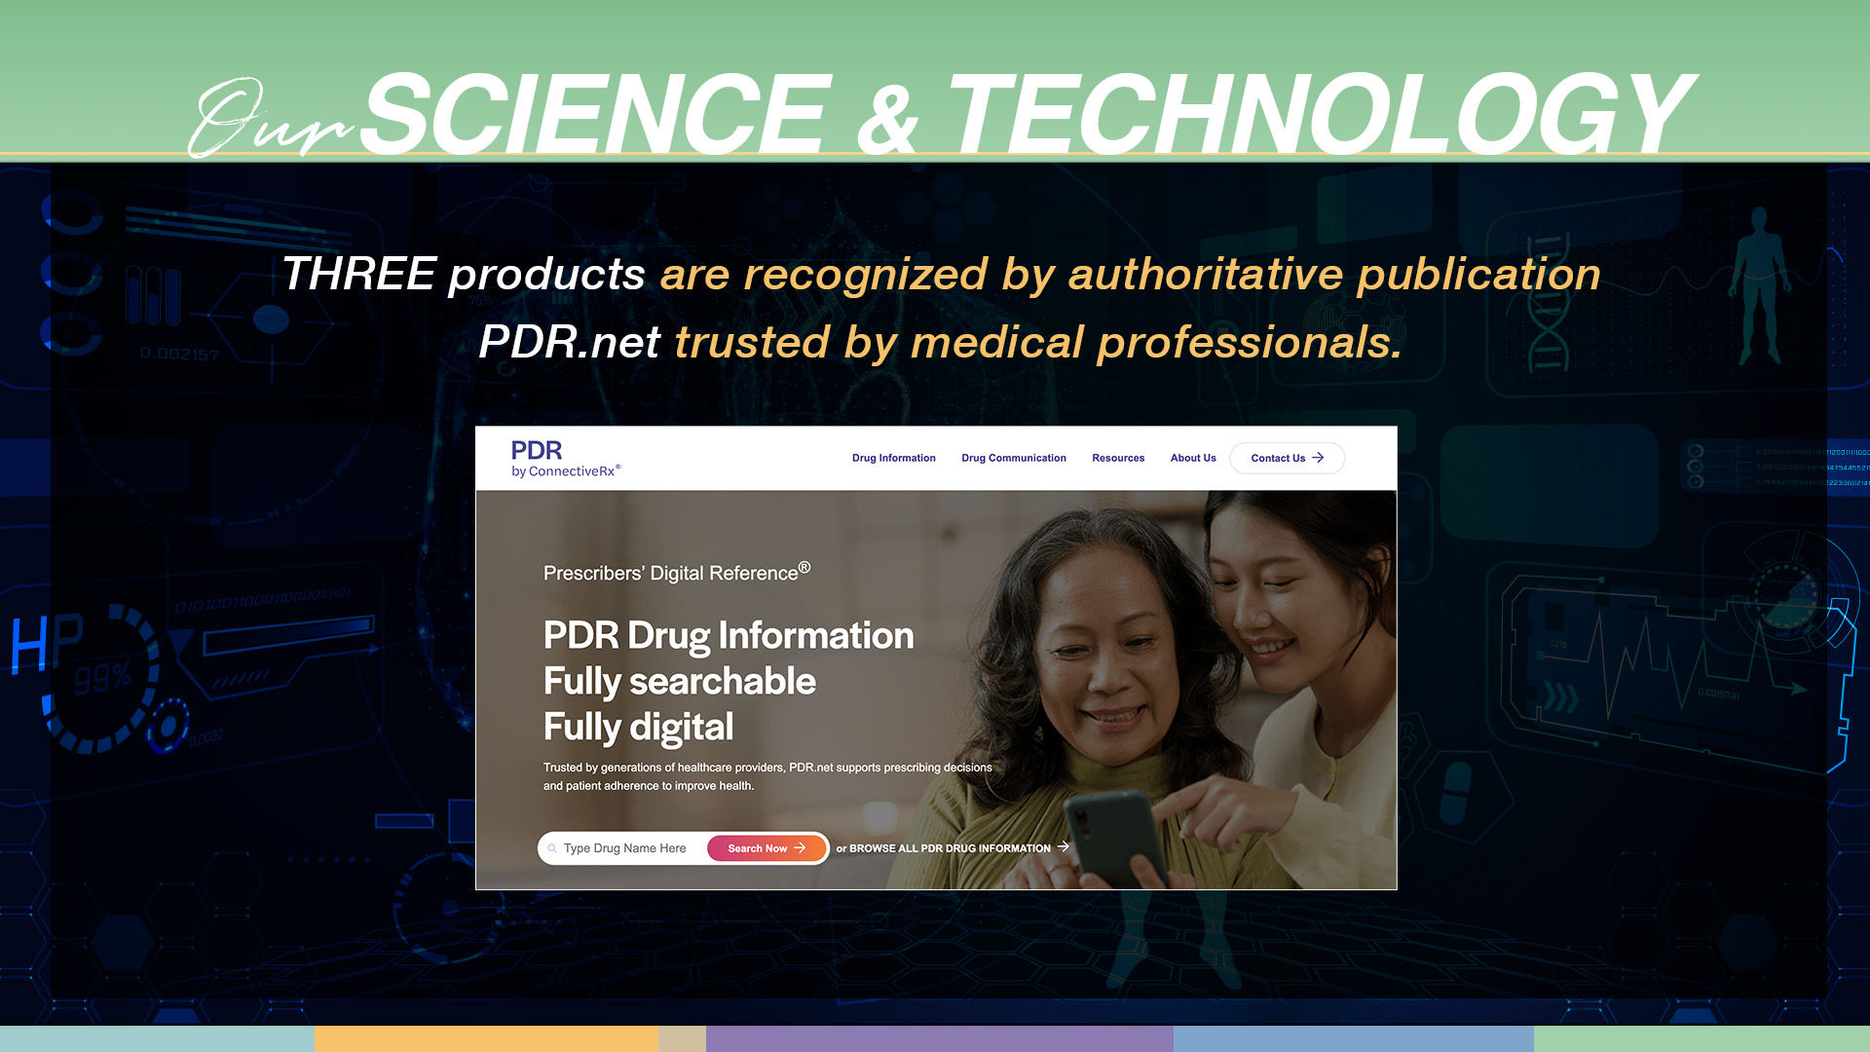

Slide 11
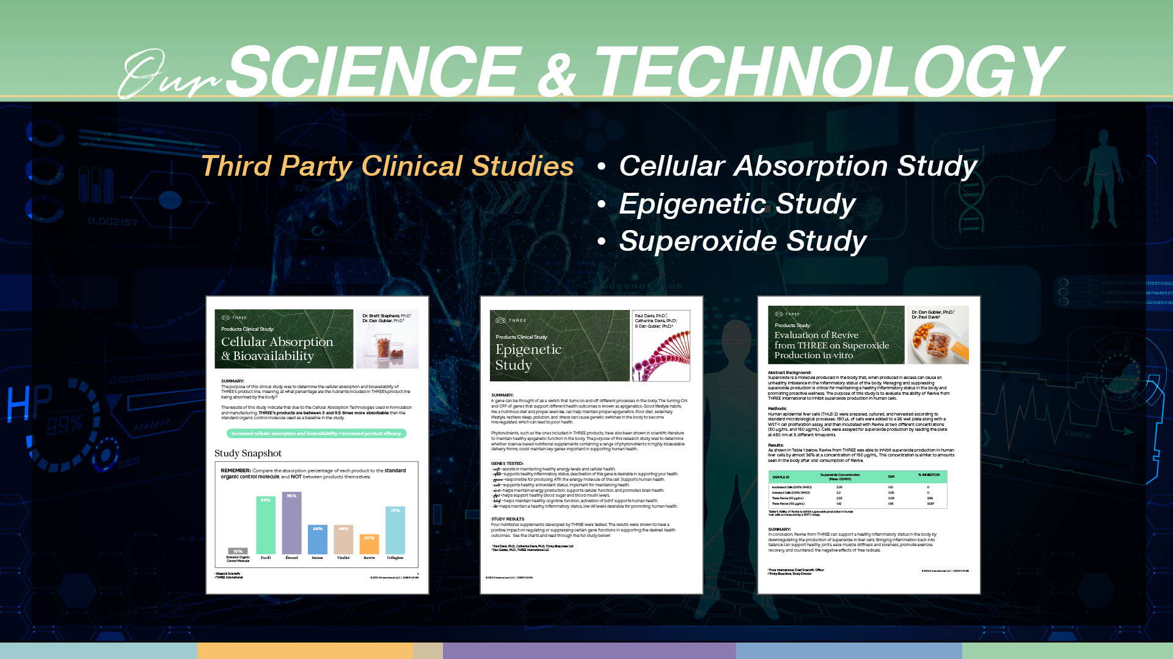

Slide 12


Slide 13

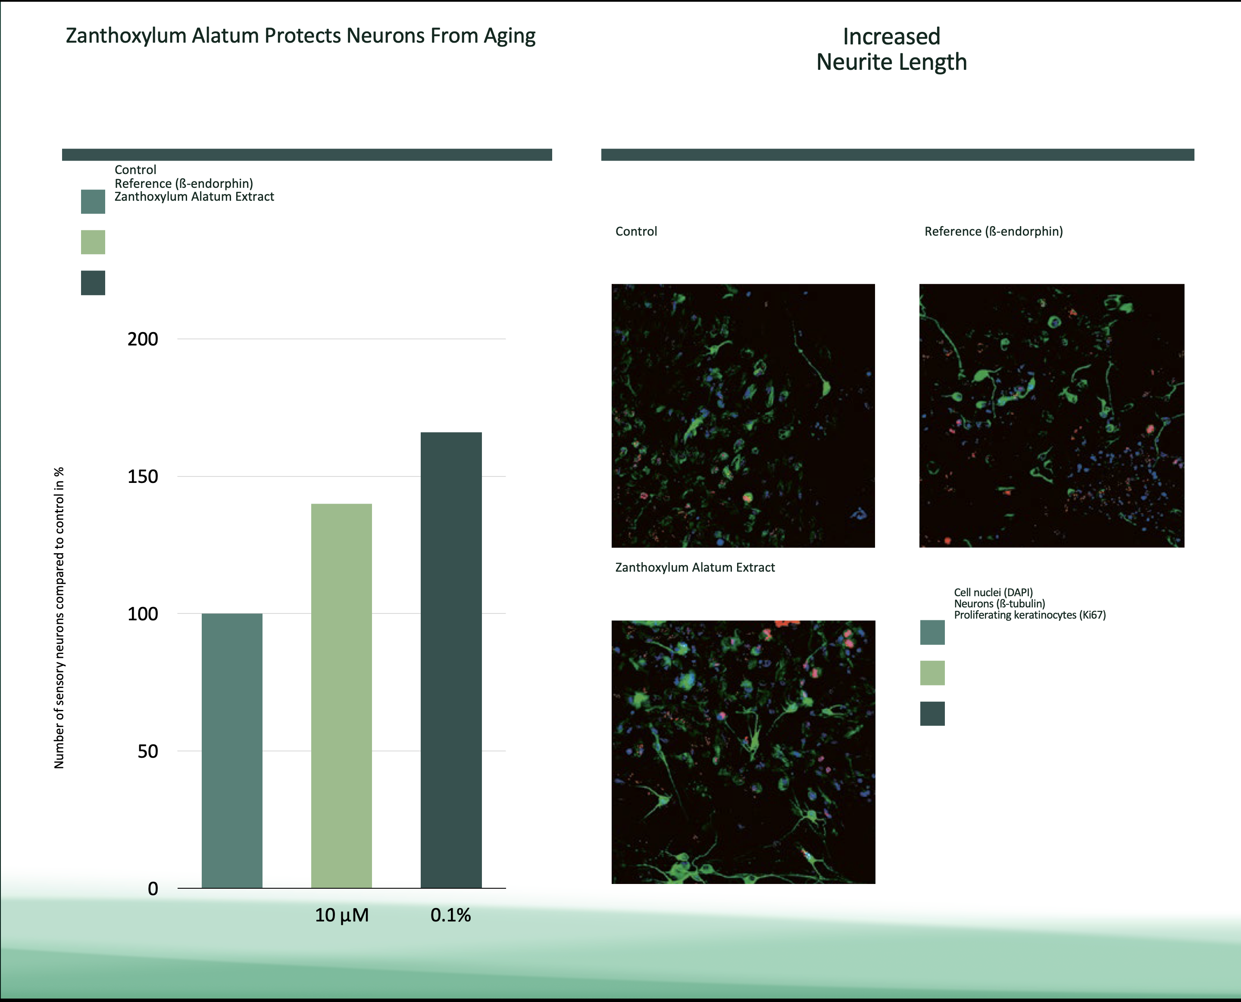
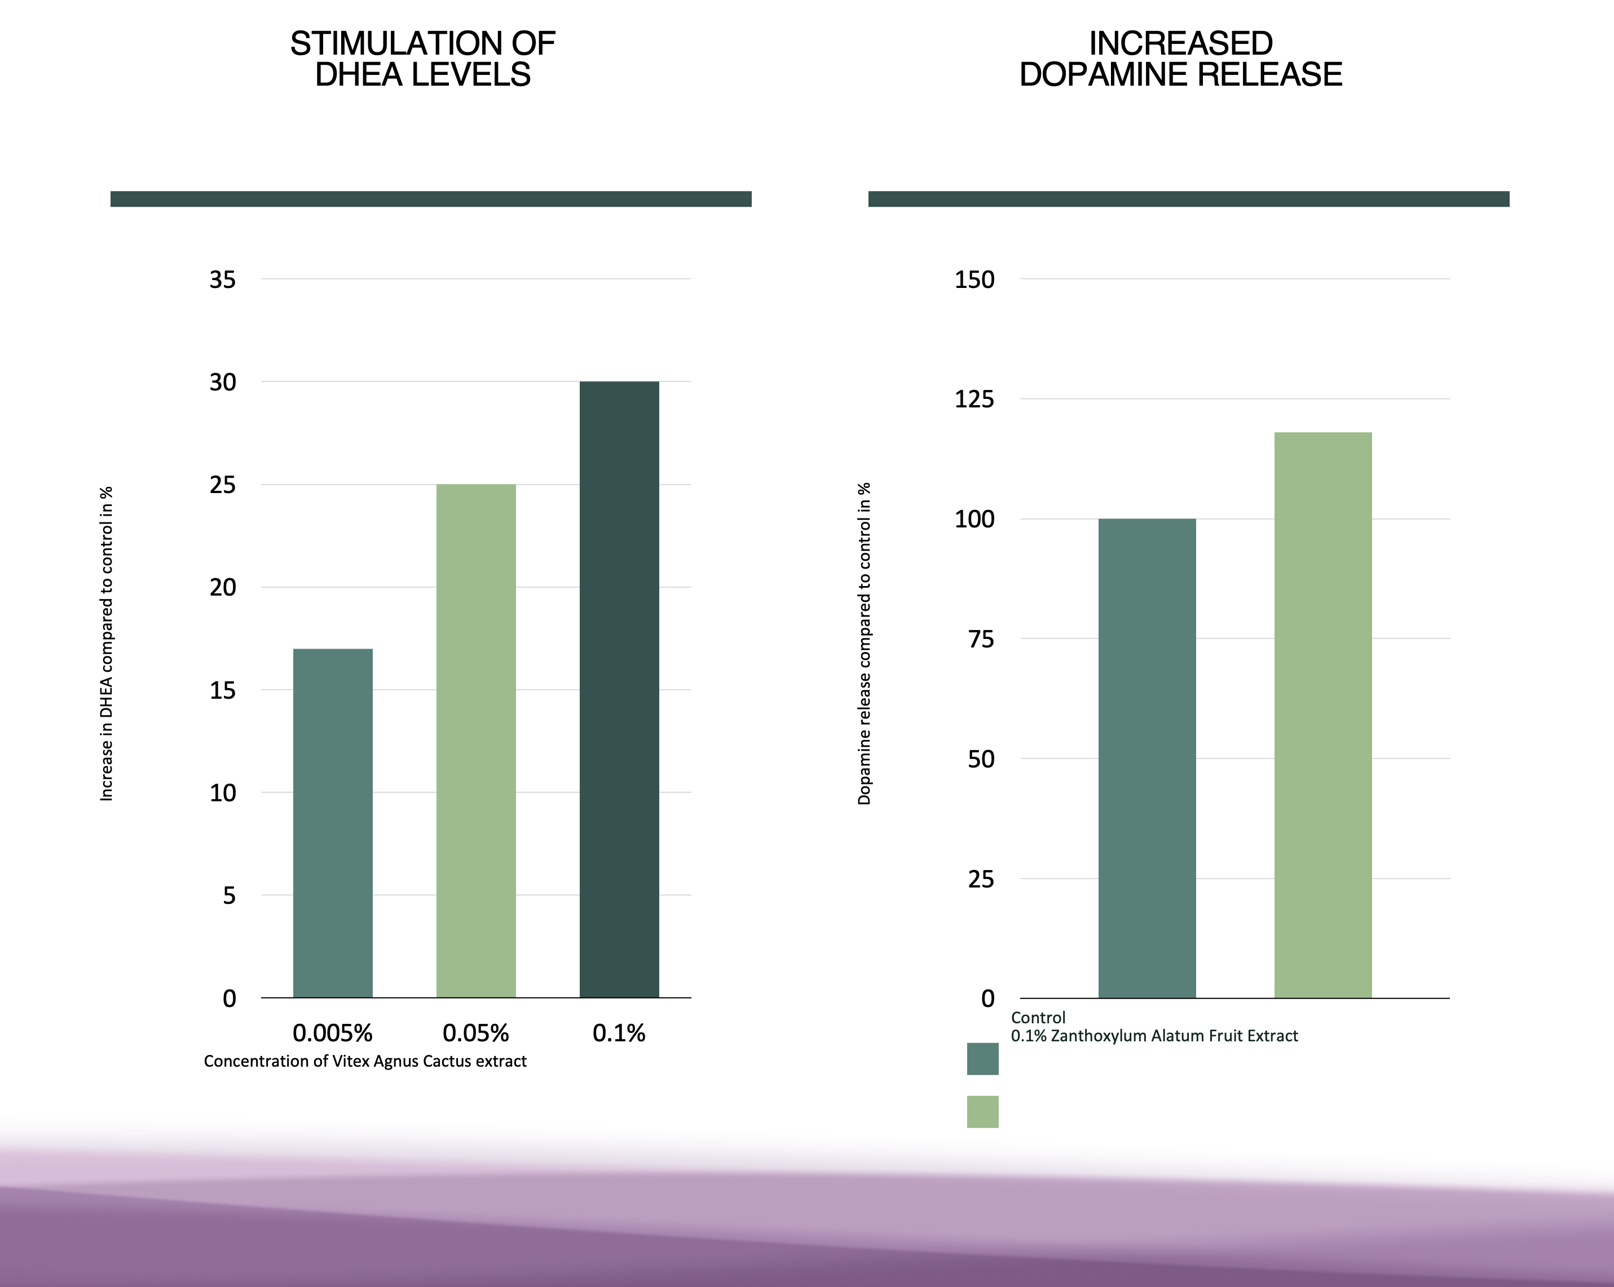
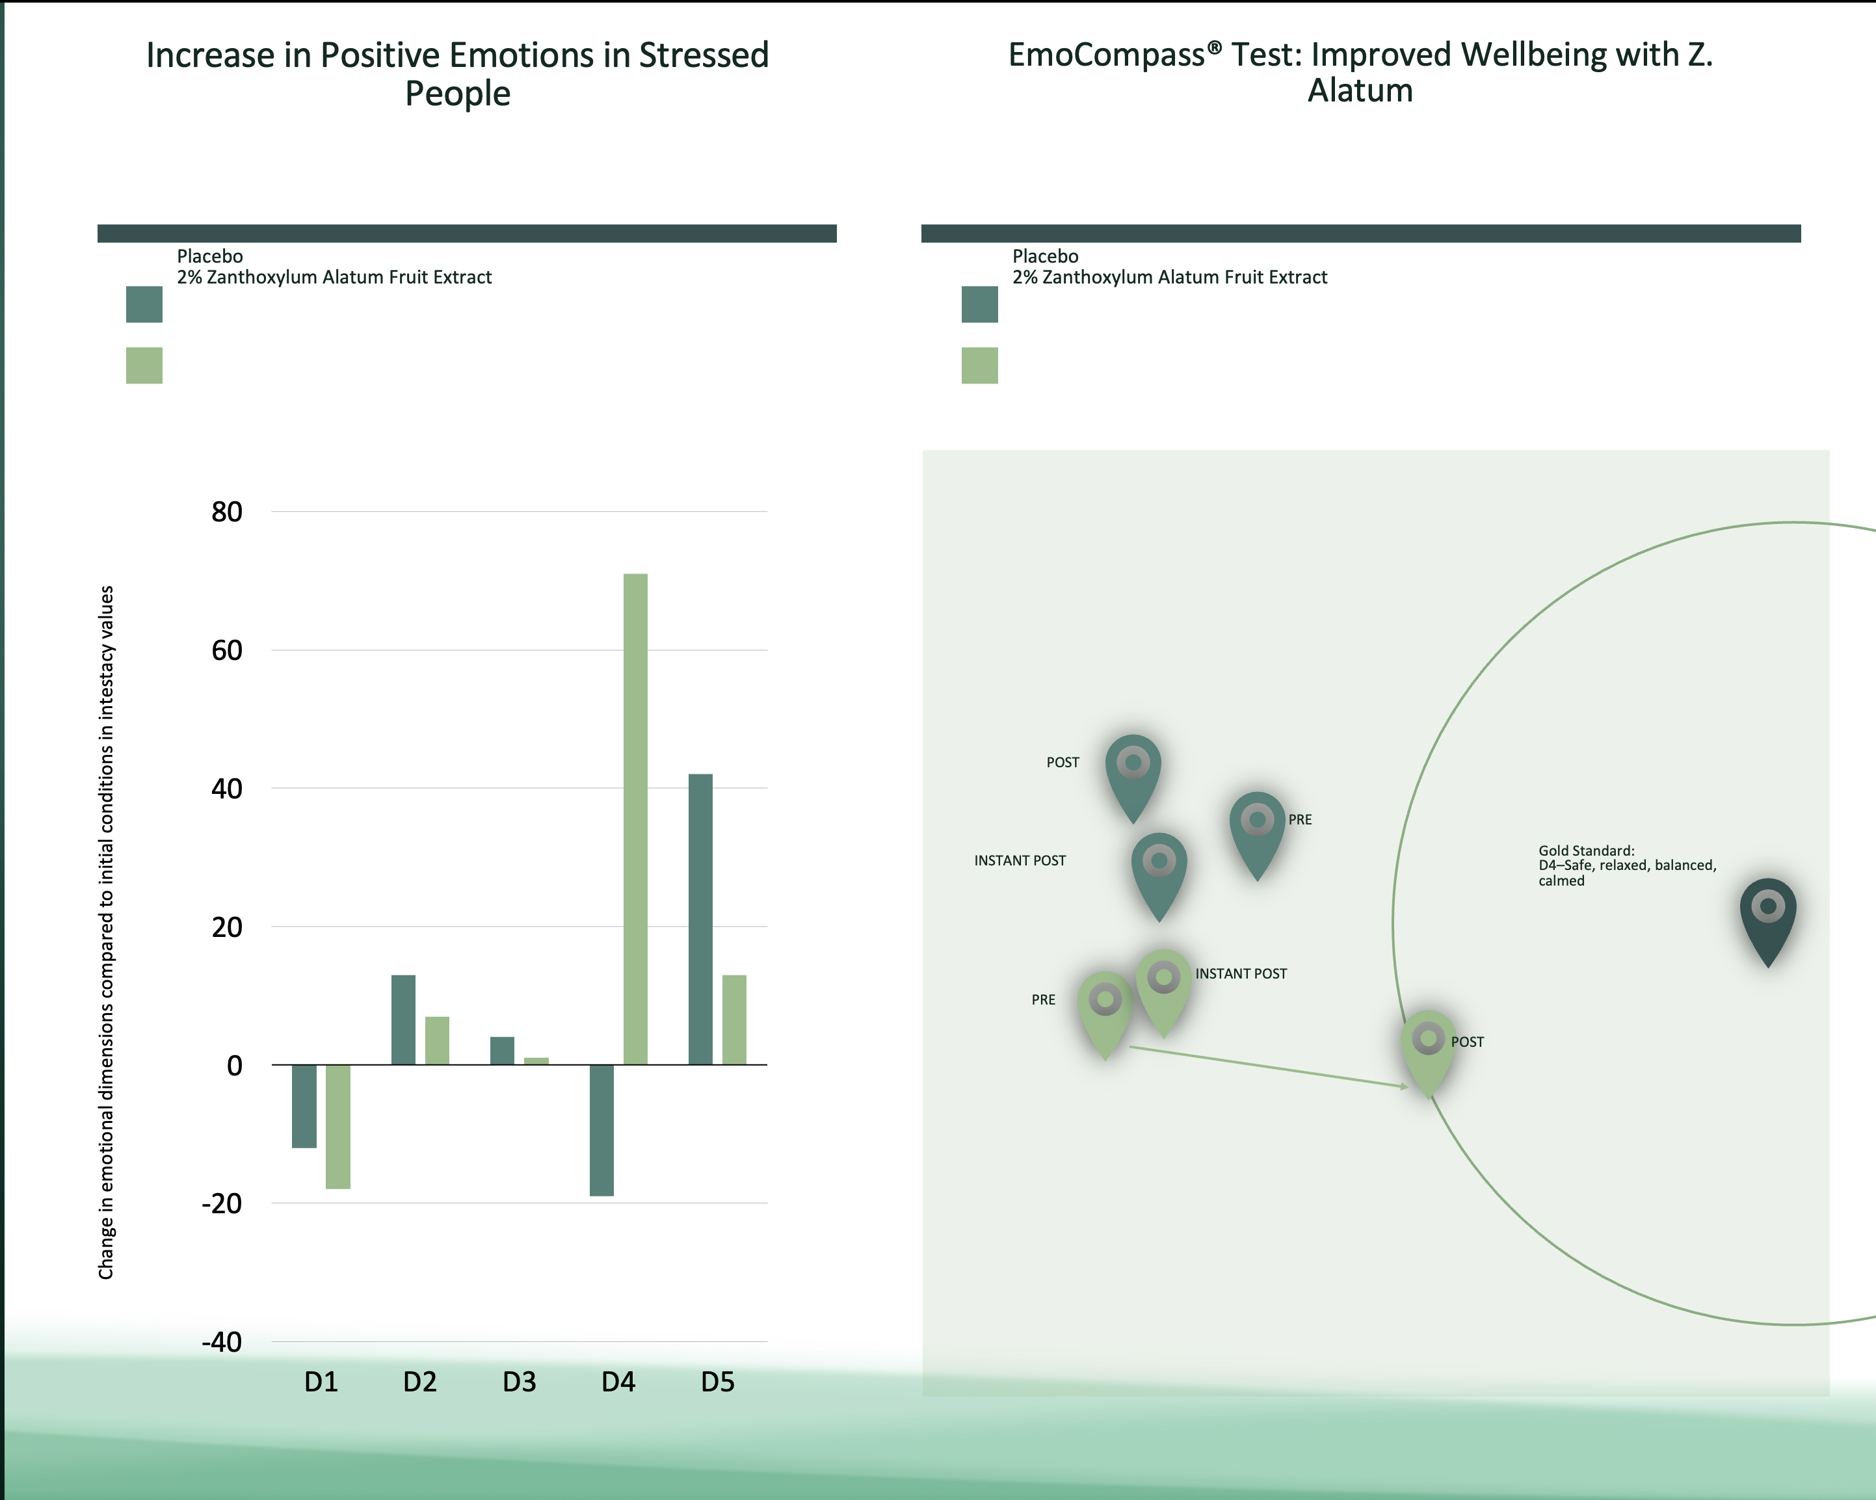
CURATED WITH DISCOVERIES FOR NEW RESULTS
VISAGE COLLECTION
Cutting Edge Neurocosmetic
World’s first cosmetic that uses the skin brain connection
Visage Super Serum Supports Health of Skin, Neurites, and Feel Good Molecules
Newly Discovered Molecules, Curation, and New Absorption Technologies
Pure Cleanse & Radiant Toner features new Quorum Sensing Technology for healthier skin
Clinical Studies
Increase Neurite Length
Stimulation of DHEA levels
INCREASED Dopamine Release
Increase in Positive Emotions in Stressed People
EmoCompass® Test: Improved Wellbeing with Z. Alatum
Notes:
Key Benefits
Provides a visible reduction in wrinkles and expression lines.
Supports a hydrated complexion and enhances skin tone.
Nurtures existing healthy skin and supports skin comfort.
Tackles environmental factors that affect skin over time.
Enhances overall sense of well-being with every application.
Cellular Absorption Technologies used
Adjuvants
Polyphenal Complexation
Molecular Shuttles
THREE Miracle Elixir
CORIANDRUM SATIVUM
Supports skin comfort and wellness, enhancing resilience to environmental factors.
HELIANTHUS ANNUUS
Naturally supports the longevity molecule NAD+: supporting skin health and vitality, promoting natural rejuvenation processes.
VITEX AGNUS-CASTUS
Enhances skin elasticity and hydration, supporting collagen production.
ZANTHOXYLUM ALATUM
Nourishes and hydrates, promoting a healthy glow and appearance.

Slide 14

CURATED WITH DISCOVERIES FOR NEW RESULTS
Cutting Edge Neurocosmetic
Support Health of Skin, Neurites, and Feel Good Molecules
Newly Discovered Molecules, Curation, and New Absorption Technologies
Partner with Radiant Toner and Pure Cleanse for maximum skin wellness
Pure Cleanse features new Quorum Sensing Technology for healthier skin
Radiant Toner
Clinical Studies
VISAGE COLLECTION
Increase Neurite Length
Stimulation of DHEA levels
INCREASED Dopamine Release
Increase in Positive Emotions in Stressed People
EmoCompass® Test: Improved Wellbeing with Z. Alatum
Notes:
Key Benefits
Provides a visible reduction in wrinkles and expression lines.
Supports a hydrated complexion and enhances skin tone.
Nurtures existing healthy skin and supports skin comfort.
Tackles environmental factors that affect skin over time.
Enhances overall sense of well-being with every application.
Cellular Absorption Technologies used
Adjuvants
Polyphenal Complexation
Molecular Shuttles
THREE Miracle Elixir
CORIANDRUM SATIVUM
Supports skin comfort and wellness, enhancing resilience to environmental factors.
HELIANTHUS ANNUUS
Naturally supports the longevity molecule NAD+: supporting skin health and vitality, promoting natural rejuvenation processes.
VITEX AGNUS-CASTUS
Enhances skin elasticity and hydration, supporting collagen production.
ZANTHOXYLUM ALATUM
Nourishes and hydrates, promoting a healthy glow and appearance.

Slide 15


Slide 16


Slide 17



Slide 18


Slide 19


Slide 20


Slide 21


