Slide 1
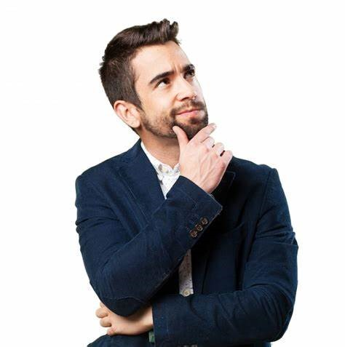
We are Looking for People Who are Looking.
Are YOU Looking?

Slide 2

Why THREE ?
1.Start your Own Business
2. Do not have to give up what you are doing
3. Does not cost a lot of money to start
4. You do not have to know anything about business as you will have a mentor/system
5. Unlimited Income Potential
6. Ongoing Income Potential

Slide 3
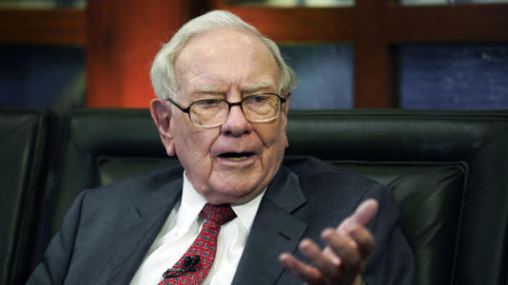
Billionare Warren Buffett has shared financial wisdom for many years. Here are a couple of his messages:
“If you don’t find a way to make money while you sleep, you will work until you die.”
“Never depend on a single income.”

Slide 4

Would you be surprised to know that you are
already doing what we do everyday,
BUT you are not getting paid for it?
If you follow 100 people from age 20 to 65,
1=RICH 4= FINANCIALLY INDEPENDENT 95 = DEAD, BROKE,
OR DEPENDENT
Let’s Learn How Money is Made !

Slide 5

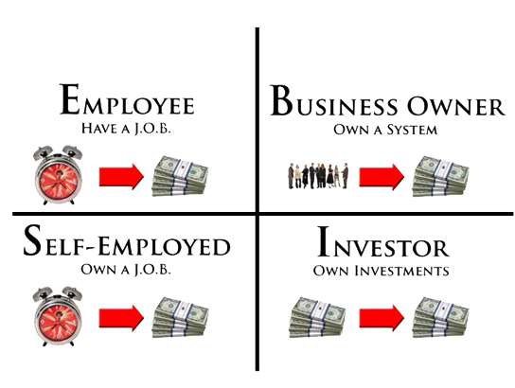

4 WAYS TO
PRODUCE INCOME
95% US Population
5% Wealth
5% US Population
95% Wealth

Slide 6



Dreams
$$
Notes:
Remember when you were young and you had dreams of what you life was going to be like
For most that ended when we got our first paycheck and most people are not living their dream
Instead they are living to survive
You either have to shrink your dreams to fit you income or grow your income to fit your dreams

Slide 7

45 YEAR PLAN
Income
Time

Slide 8


The Secret of Success
A----------Vehicle---------B
What is YOUR Prime Motivating Factor?

Slide 9
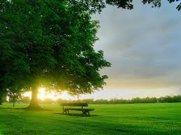


Looking Zone

Slide 10
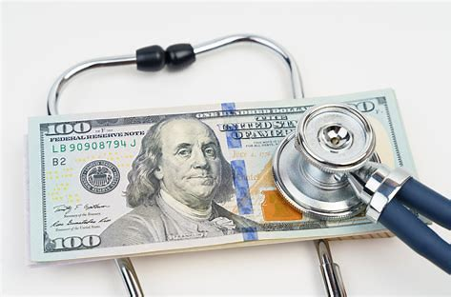

TRENDING TODAY
HEALTH and CROSS BORDER E-COMMERCE

Slide 11


Slide 12

The OPPORTUNITY
About THREE International
Our Foundation:
Founded Based on a Collaborative Effort From a Group of
Experienced International Business Builders.
  Headquartered in Lehi, Utah USA
  Launched on May 2023
  Currently Have Offices in Hong Kong and Indonesia

Slide 13


Slide 14

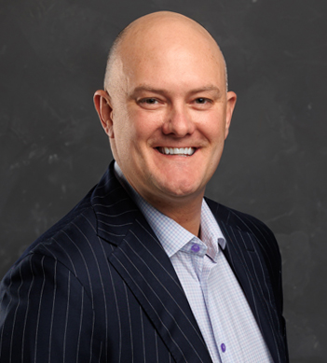
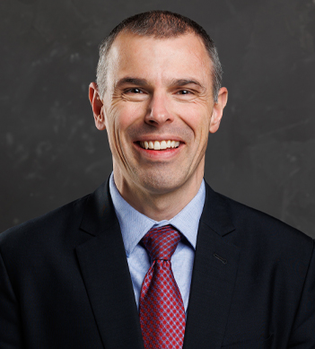
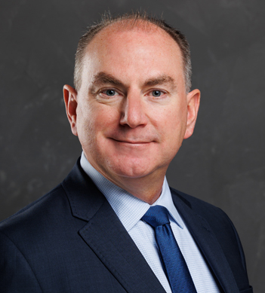
DANIEL PICOU
Founder & CEO
DR. DAN GUBLER
CHIEF SCIENTIFIC OFFICER
TROY MOHR
COO

Slide 15

Notes:
v

Slide 16


Slide 17


Slide 18

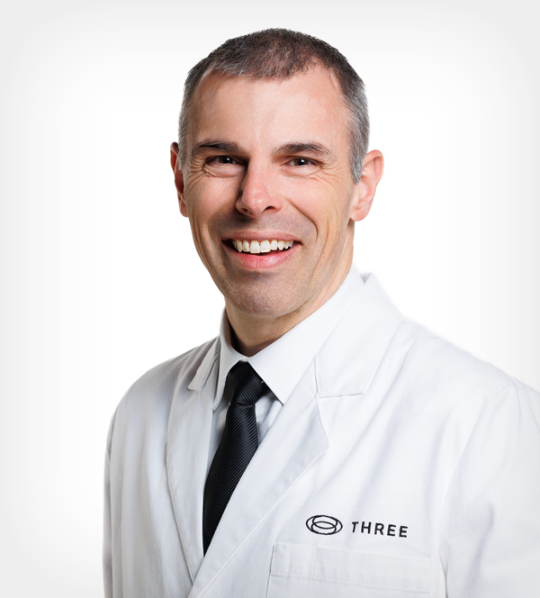
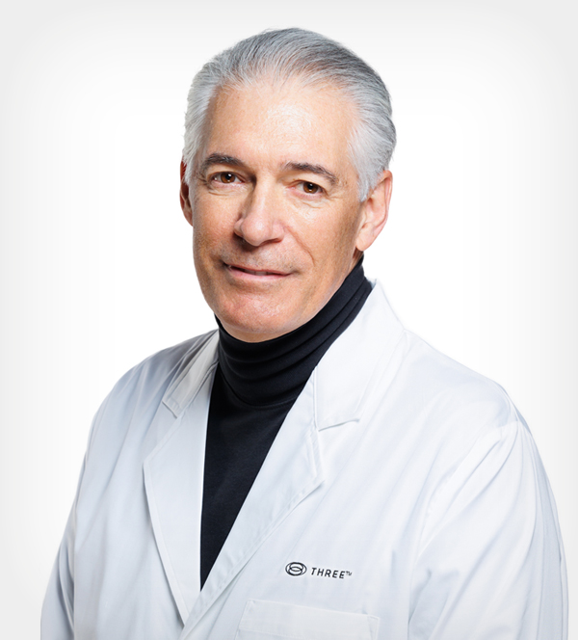
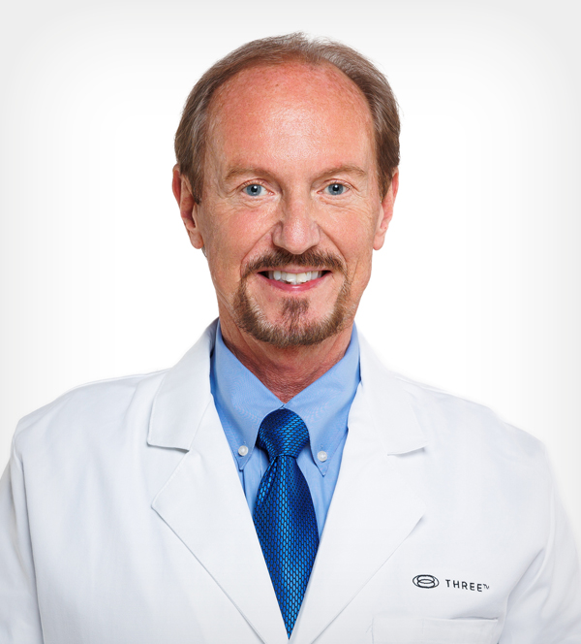
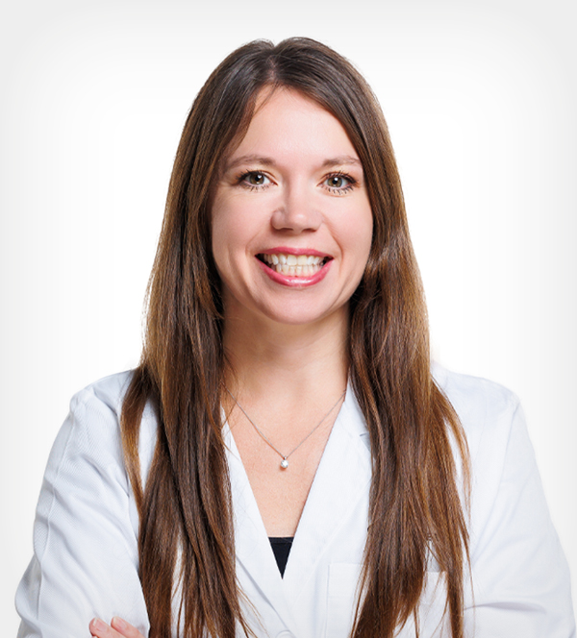
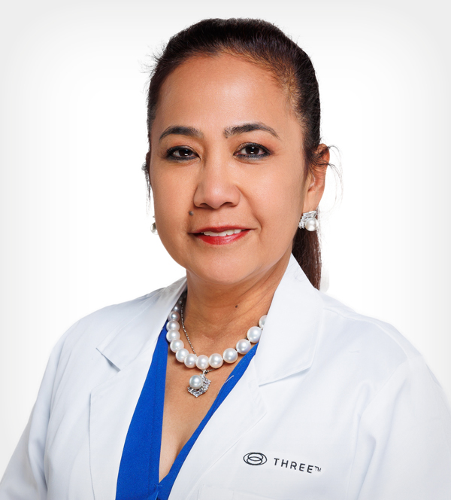
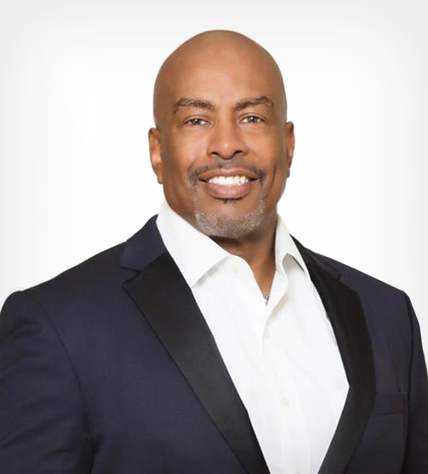
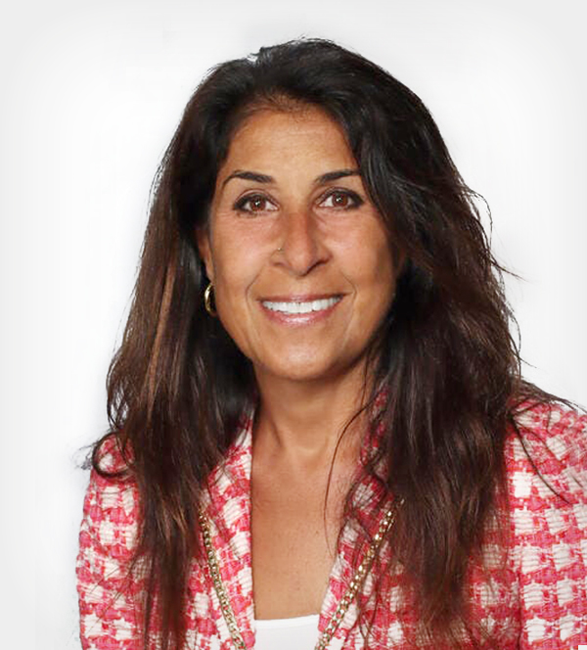
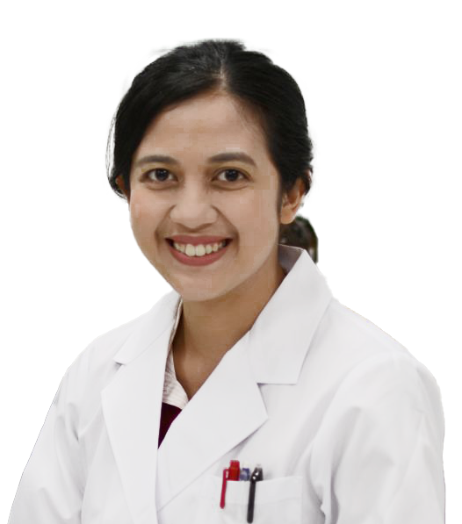
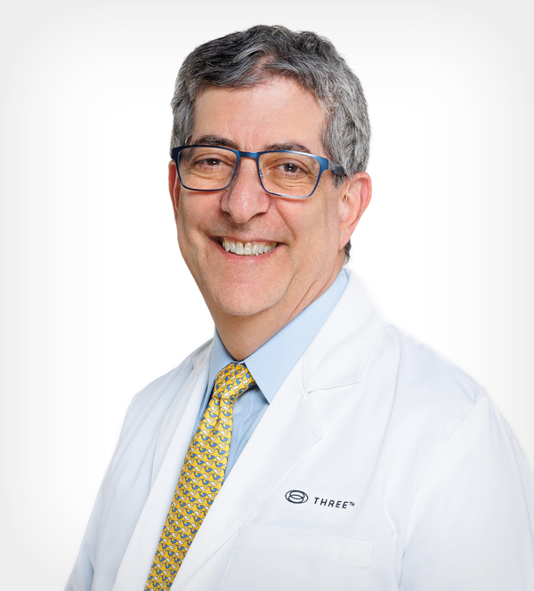
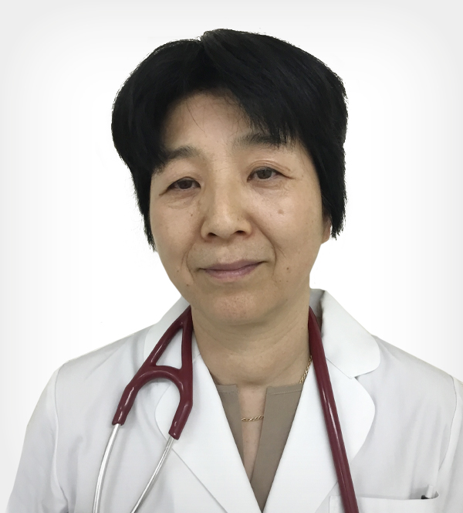
DR. DAN GUBLER
Ph.D. | Chief Scientific Officer
DR. TIMOTHY SCHNEIDER
MD | SAB Chair
DR. JAMES BAKER
DO, FACOI
DR. JESSICA BORDON
DPM, PA
DR. LANA GALICIA
MD
DR. CHARLES GREENE
MD, Ph.D.
DR. CATHERINE MADAFFARI
MD
PROFESSOR SASTIA PUTRI
Ph. D.
DR. STEPHEN SABO
MD
DR. NAOKO YOSHIMURA
MD

Slide 19
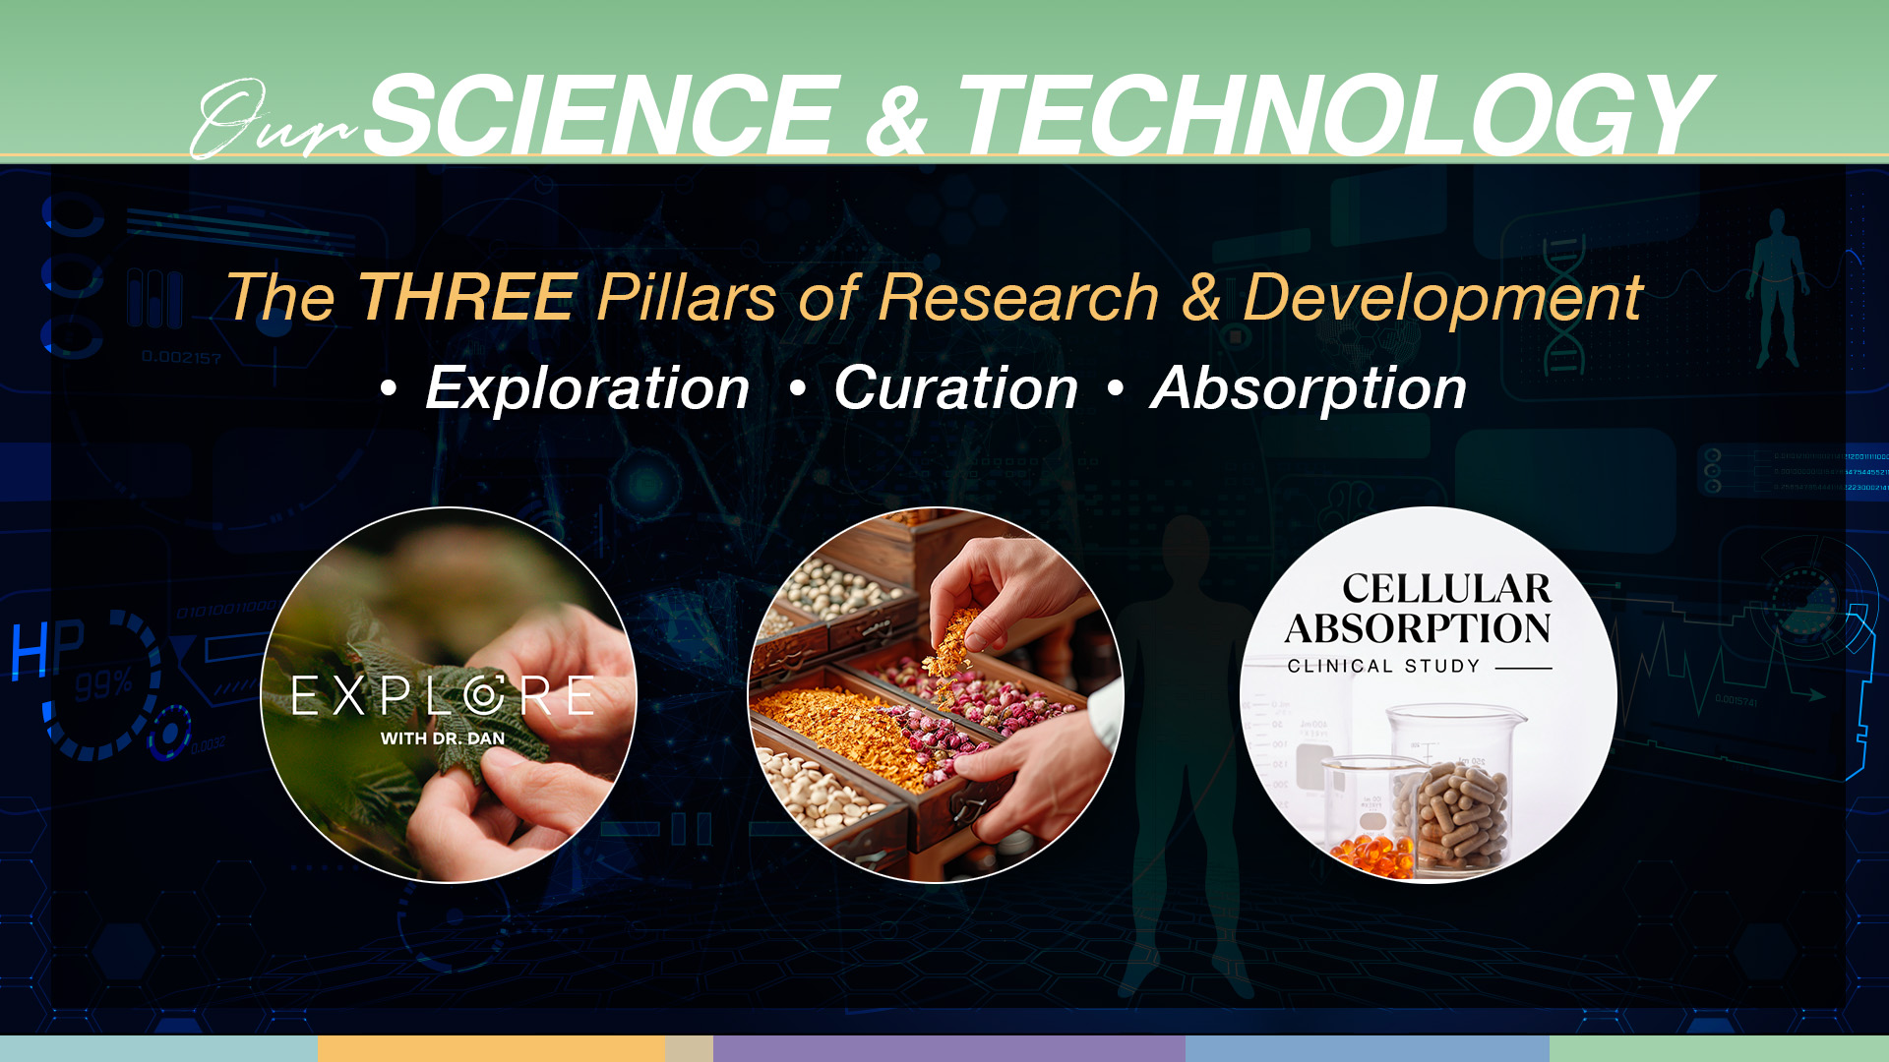
The THREE EDGE

Slide 20
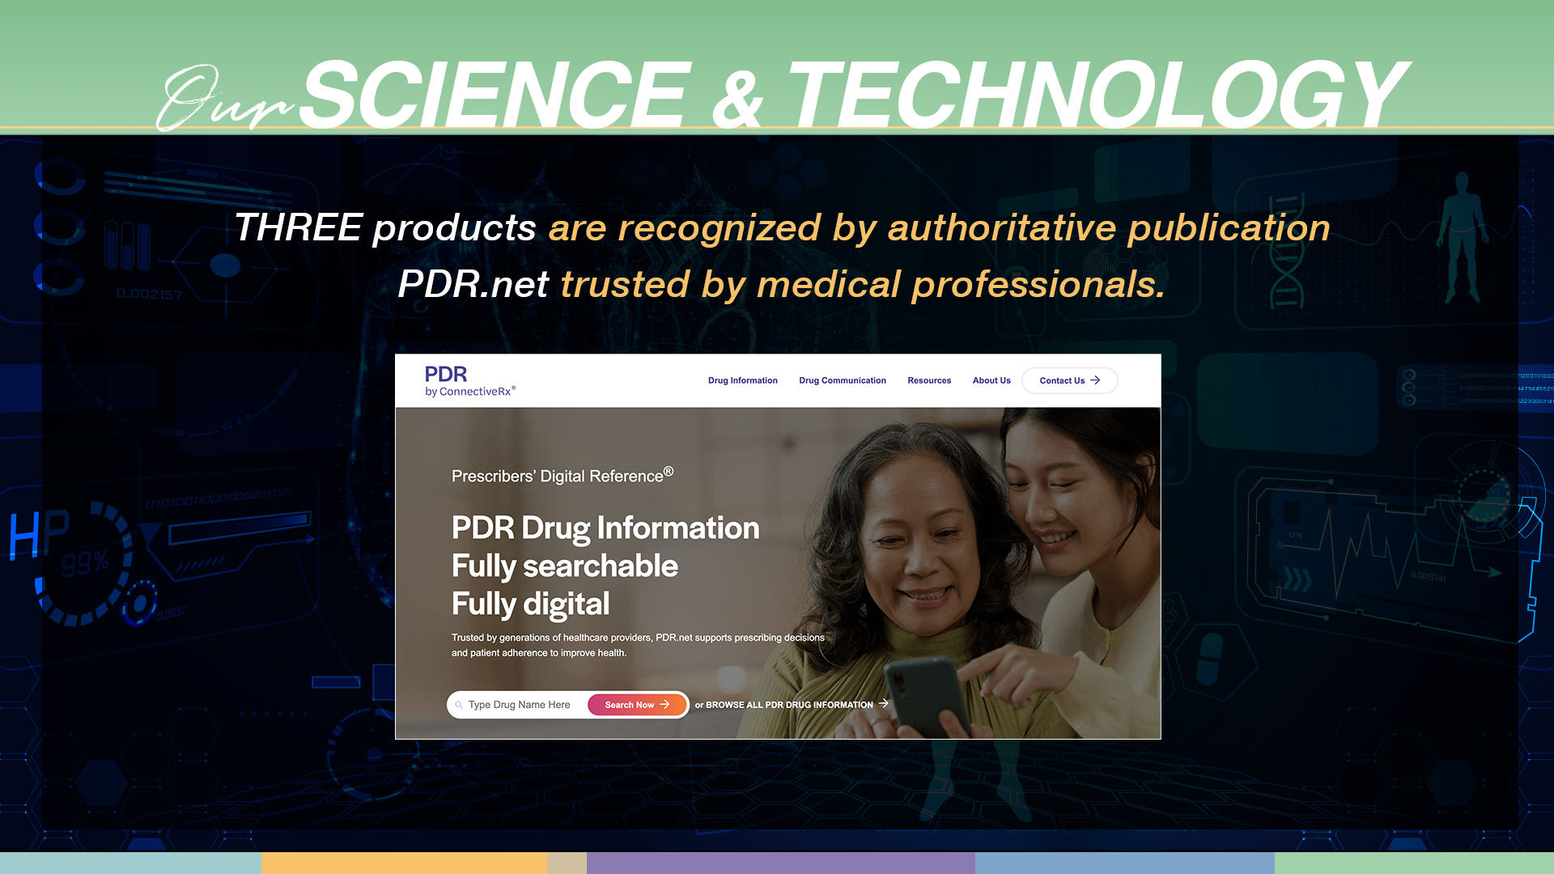

Slide 21
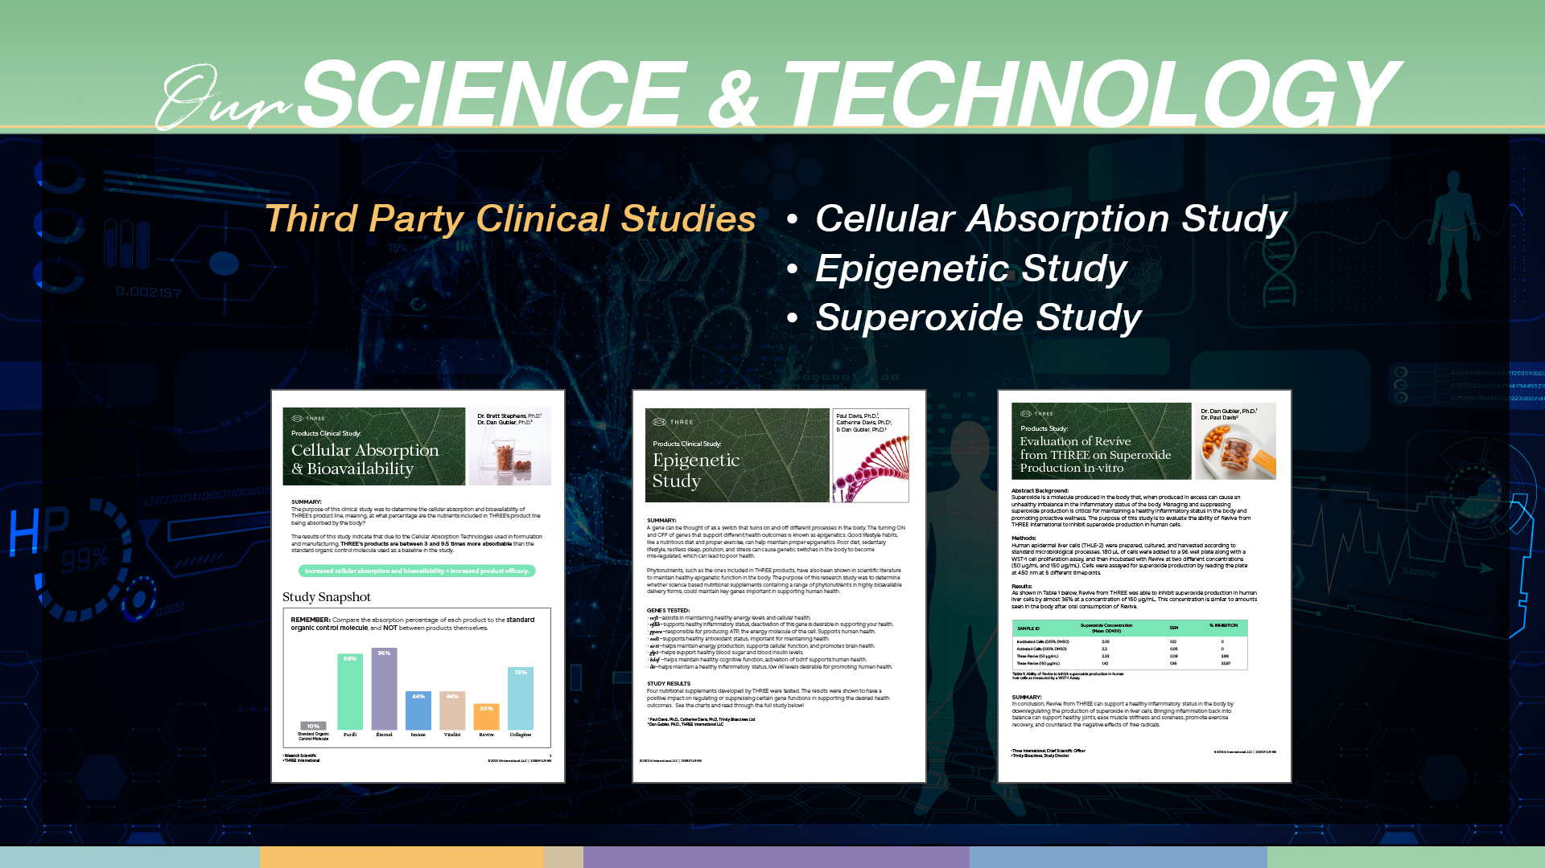

Slide 22


Slide 23



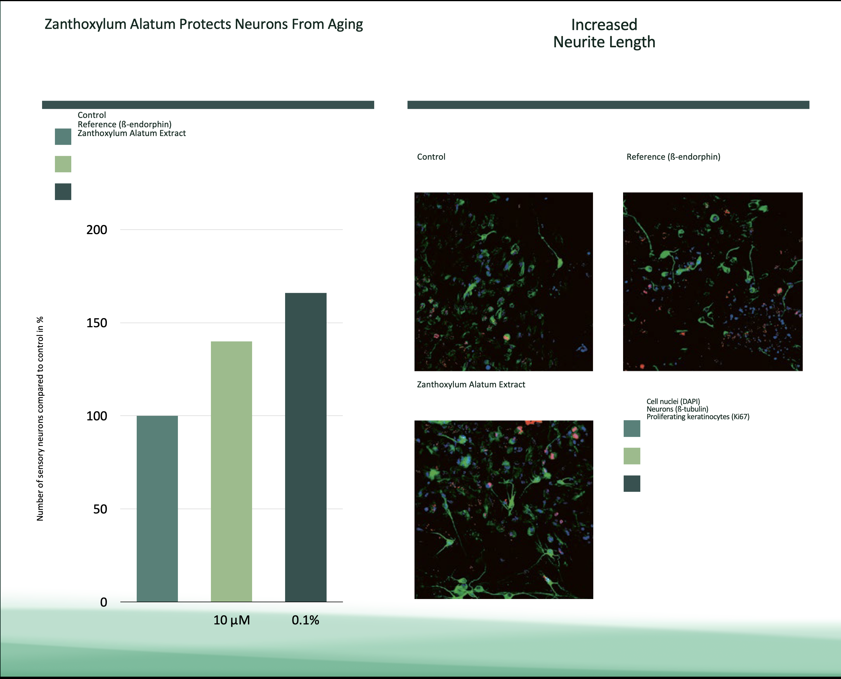
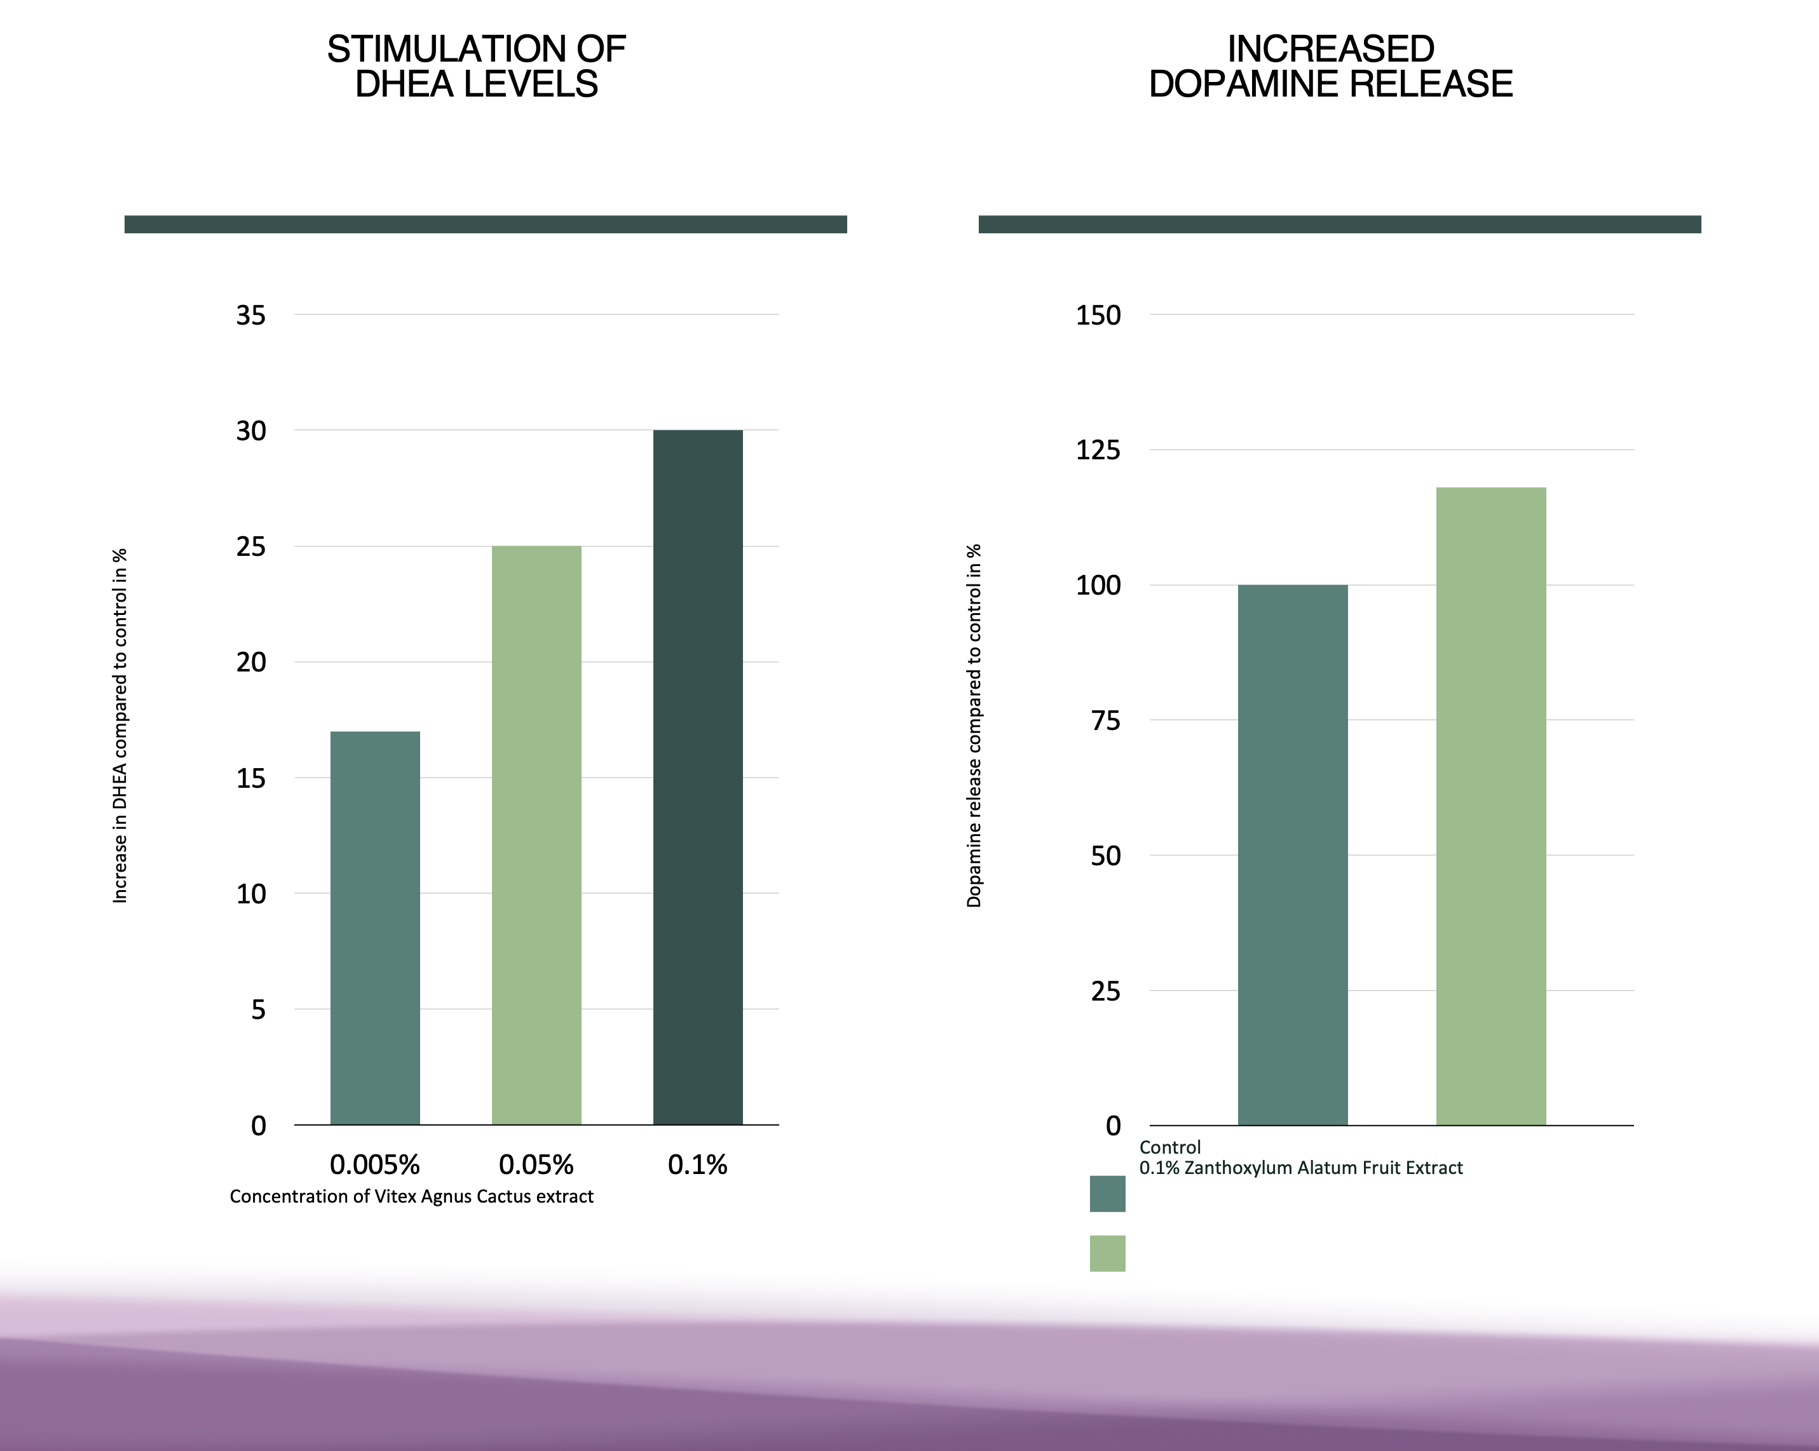
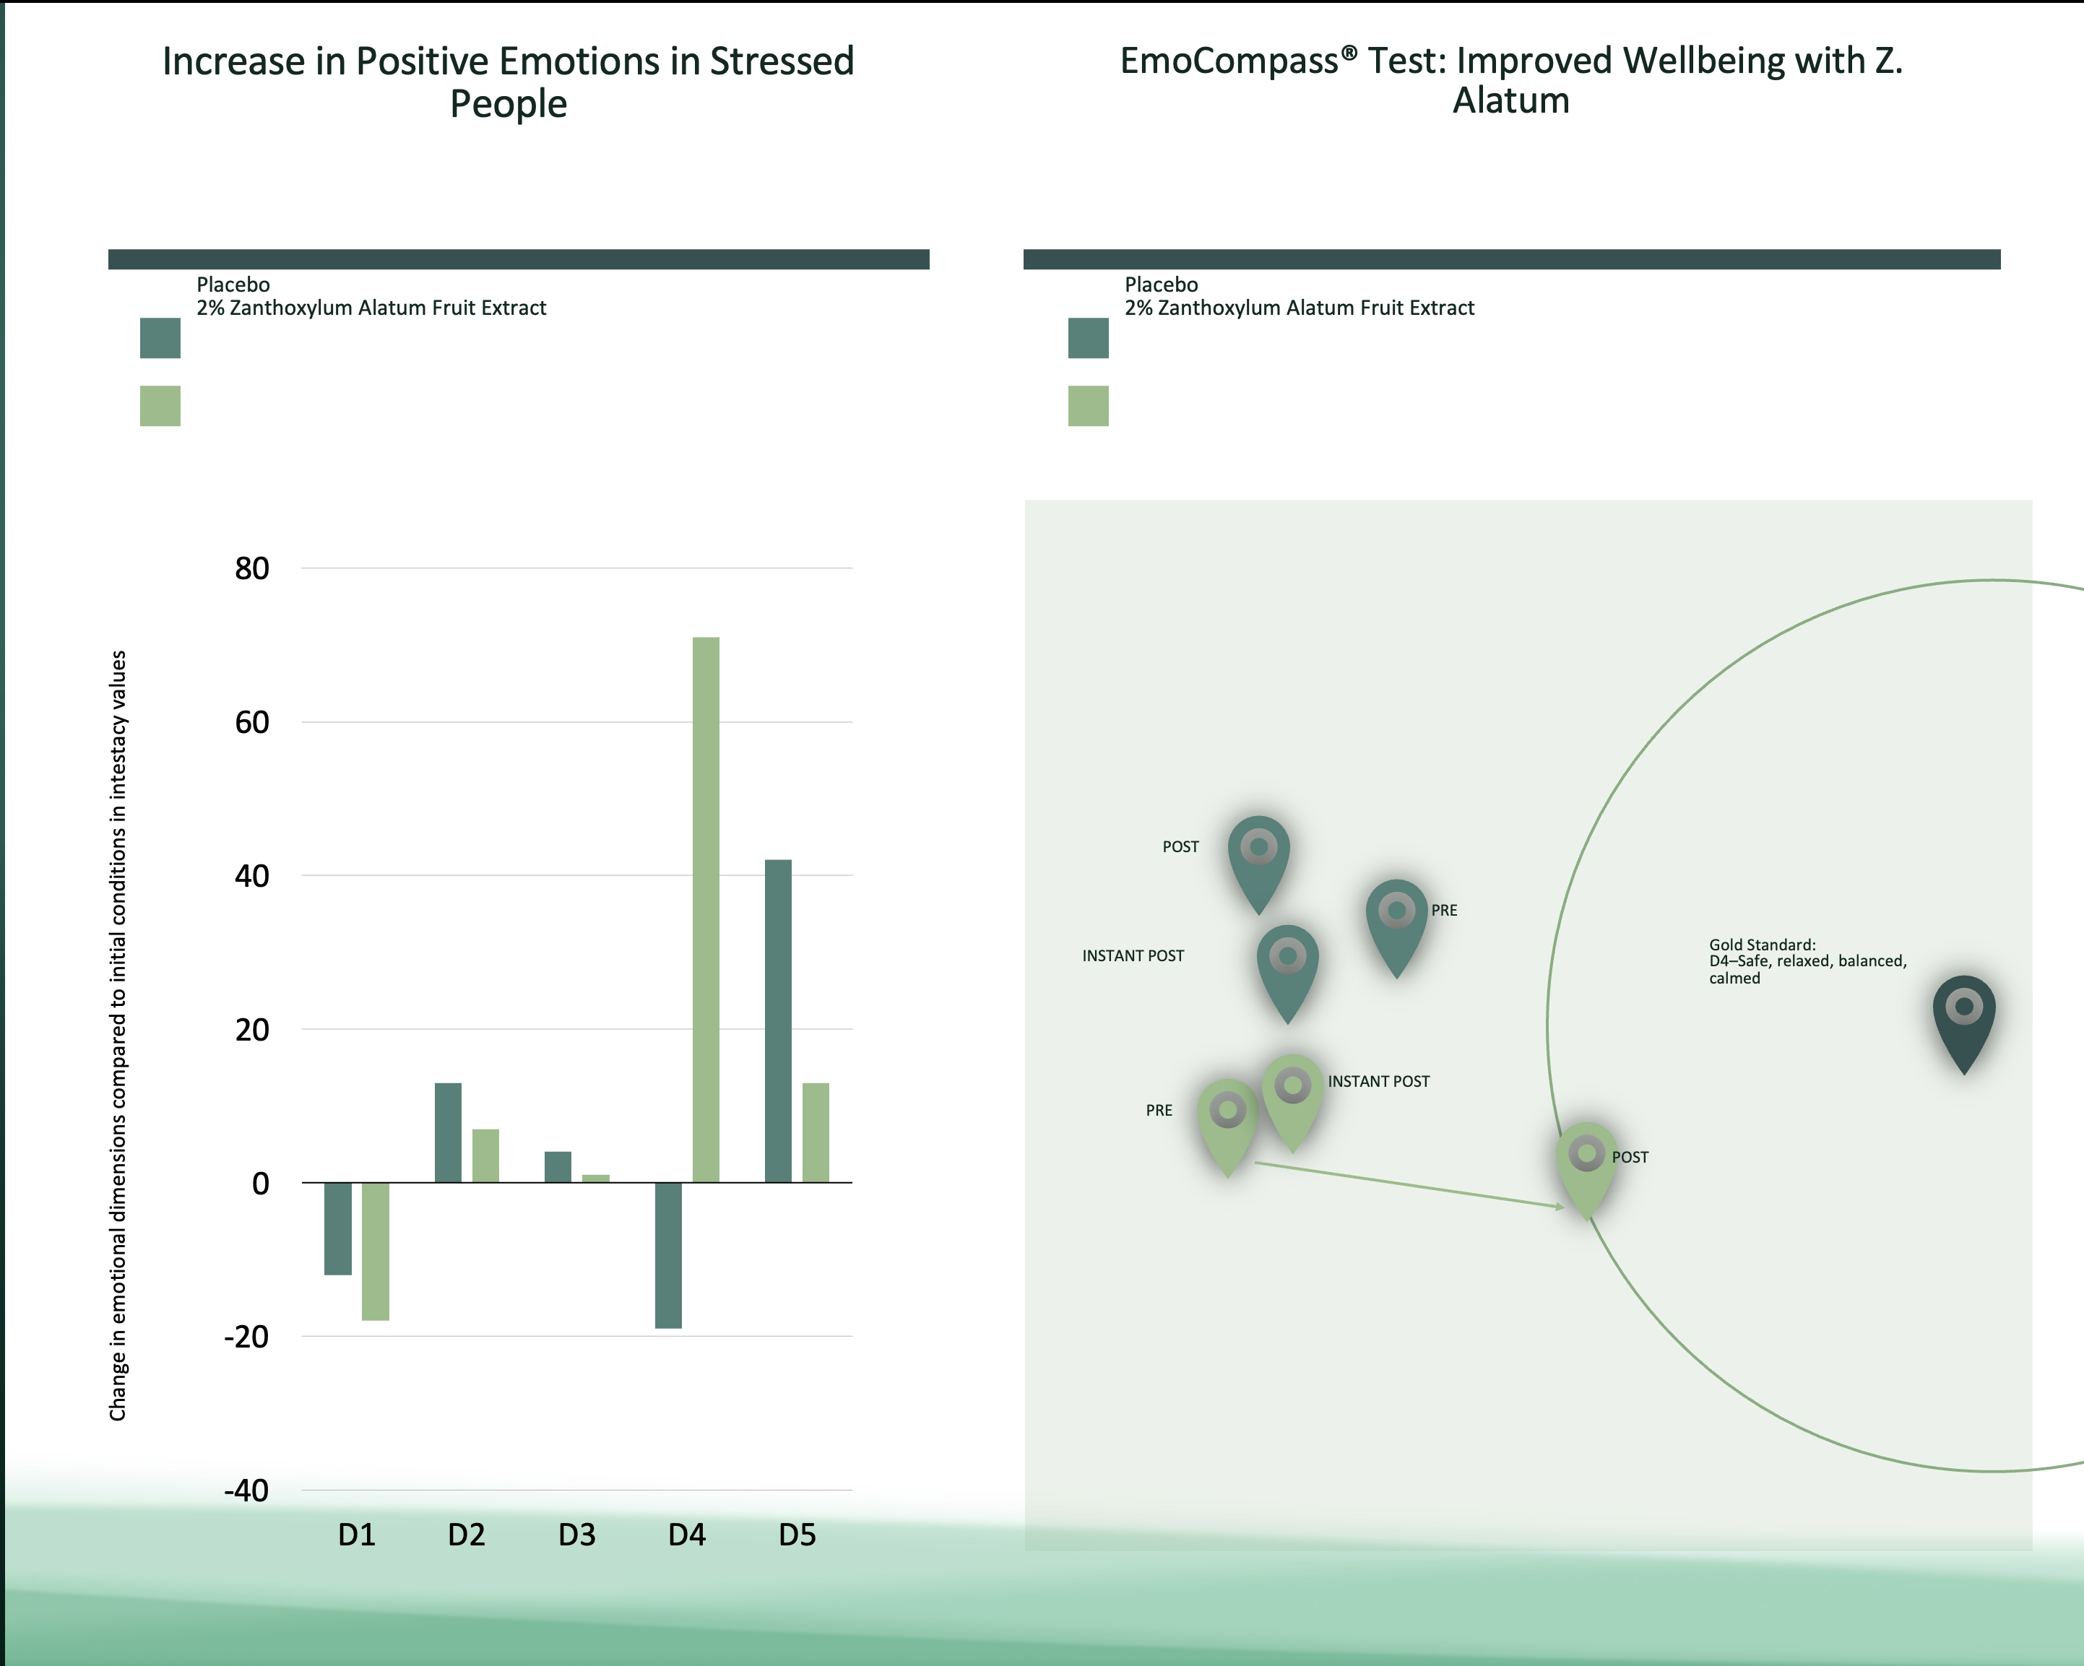
CURATED WITH DISCOVERIES FOR NEW RESULTS
Cutting Edge Neurocosmetic
Support Health of Skin, Neurites, and Feel Good Molecules
Newly Discovered Molecules, Curation, and New Absorption Technologies
Clinical Studies
Increase Neurite Length
Stimulation of DHEA levels
INCREASED Dopamine Release
Increase in Positive Emotions in Stressed People
EmoCompass® Test: Improved Wellbeing with Z. Alatum
Notes:
Key Benefits
Provides a visible reduction in wrinkles and expression lines.
Supports a hydrated complexion and enhances skin tone.
Nurtures existing healthy skin and supports skin comfort.
Tackles environmental factors that affect skin over time.
Enhances overall sense of well-being with every application.
Cellular Absorption Technologies used
Adjuvants
Polyphenal Complexation
Molecular Shuttles
THREE Miracle Elixir
CORIANDRUM SATIVUM
Supports skin comfort and wellness, enhancing resilience to environmental factors.
HELIANTHUS ANNUUS
Naturally supports the longevity molecule NAD+: supporting skin health and vitality, promoting natural rejuvenation processes.
VITEX AGNUS-CASTUS
Enhances skin elasticity and hydration, supporting collagen production.
ZANTHOXYLUM ALATUM
Nourishes and hydrates, promoting a healthy glow and appearance.

Slide 24


Slide 25


Slide 26
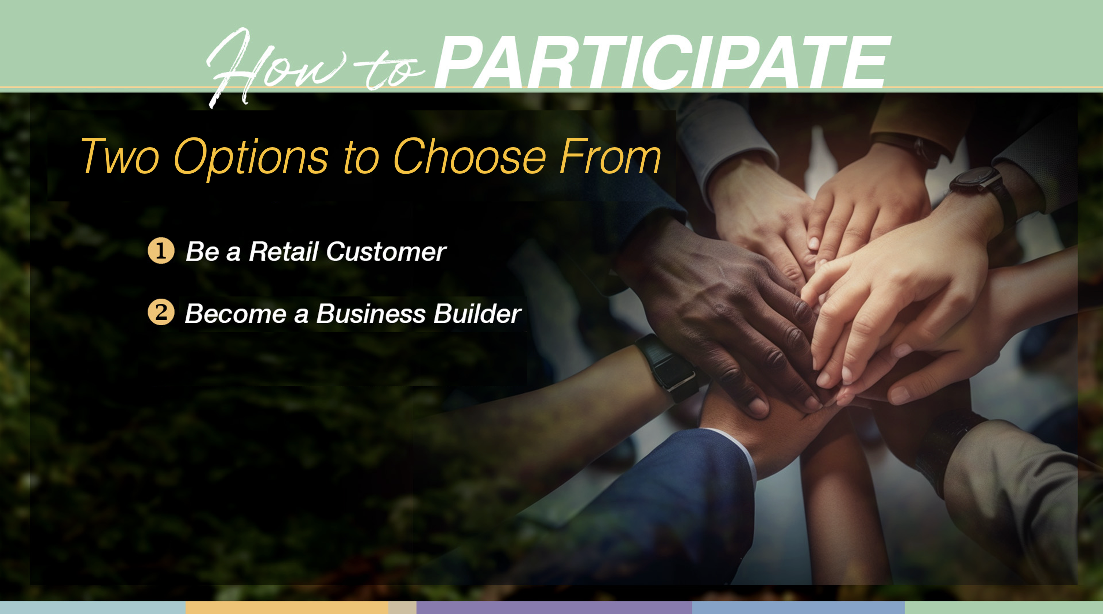

Slide 27


Slide 28


Slide 29




Brand
Ambassador
GETTING STARTED
“Brand
Ambassador ”
&
Qualified!
Enroll
Select Introduction Package
Set-Up Smart Ship
“Congratulations”
You’re ACTIVE
YOU
Left
Right
BUILD TEAMS of
“Qualified
Brand Ambassadors”
Weekly Cap：500cycles x $35 = $17,500 = $70,000/4weeks
Maximum Cap：600cycles x $45 = $27,000 = $108,000/4weeks

Slide 30

V
Leadership Matching Bonus
“HAPPY 10”
*Have 10+ customer orders / L1 Smart Ship Orders total 1000+PGV. **Matches based on $35/cycle.

Slide 31
THE TIMING OF THREE
The 4 Stages of Growth
$
GROWTH
TIME
Formulation
Concentration
MOMENTUM
Stability

Slide 32

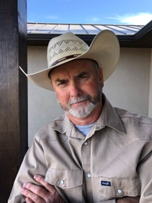
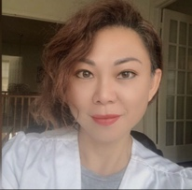

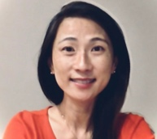
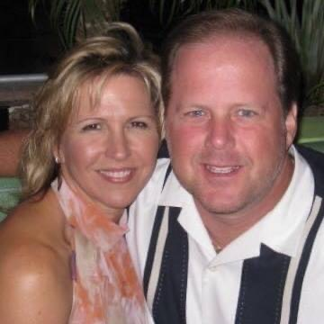
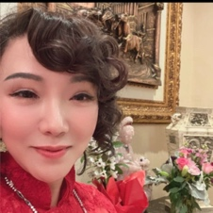

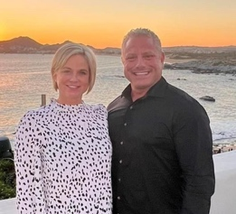

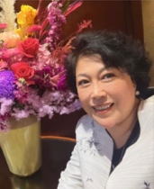
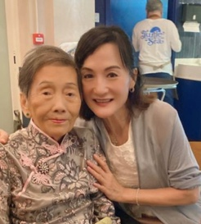
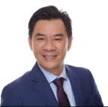
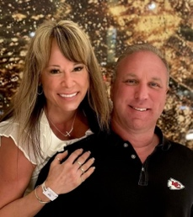
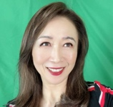
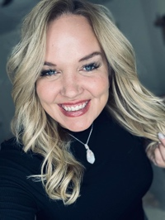
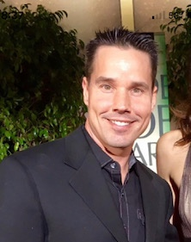
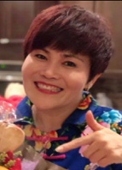
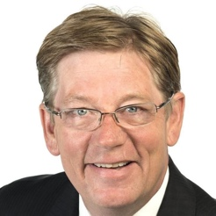
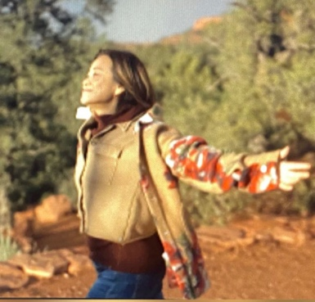
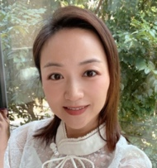
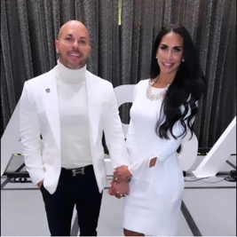
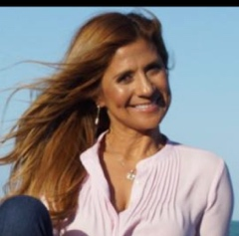
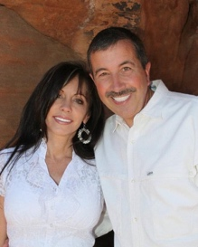
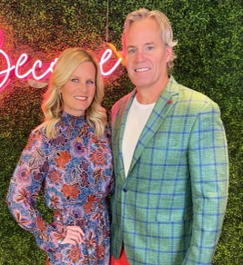
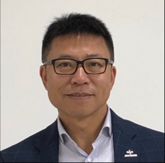
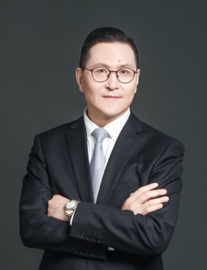
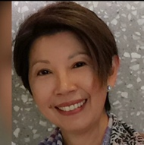
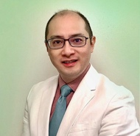











































Connect with the person who shared THREE with you!
Welcome to the Global Movement!

