Slide 1

HOW TO MAXIMIZE POWER UP POINTS

Slide 2

AVAILABLE UNTIL SEPTEMBER 15TH

Slide 3
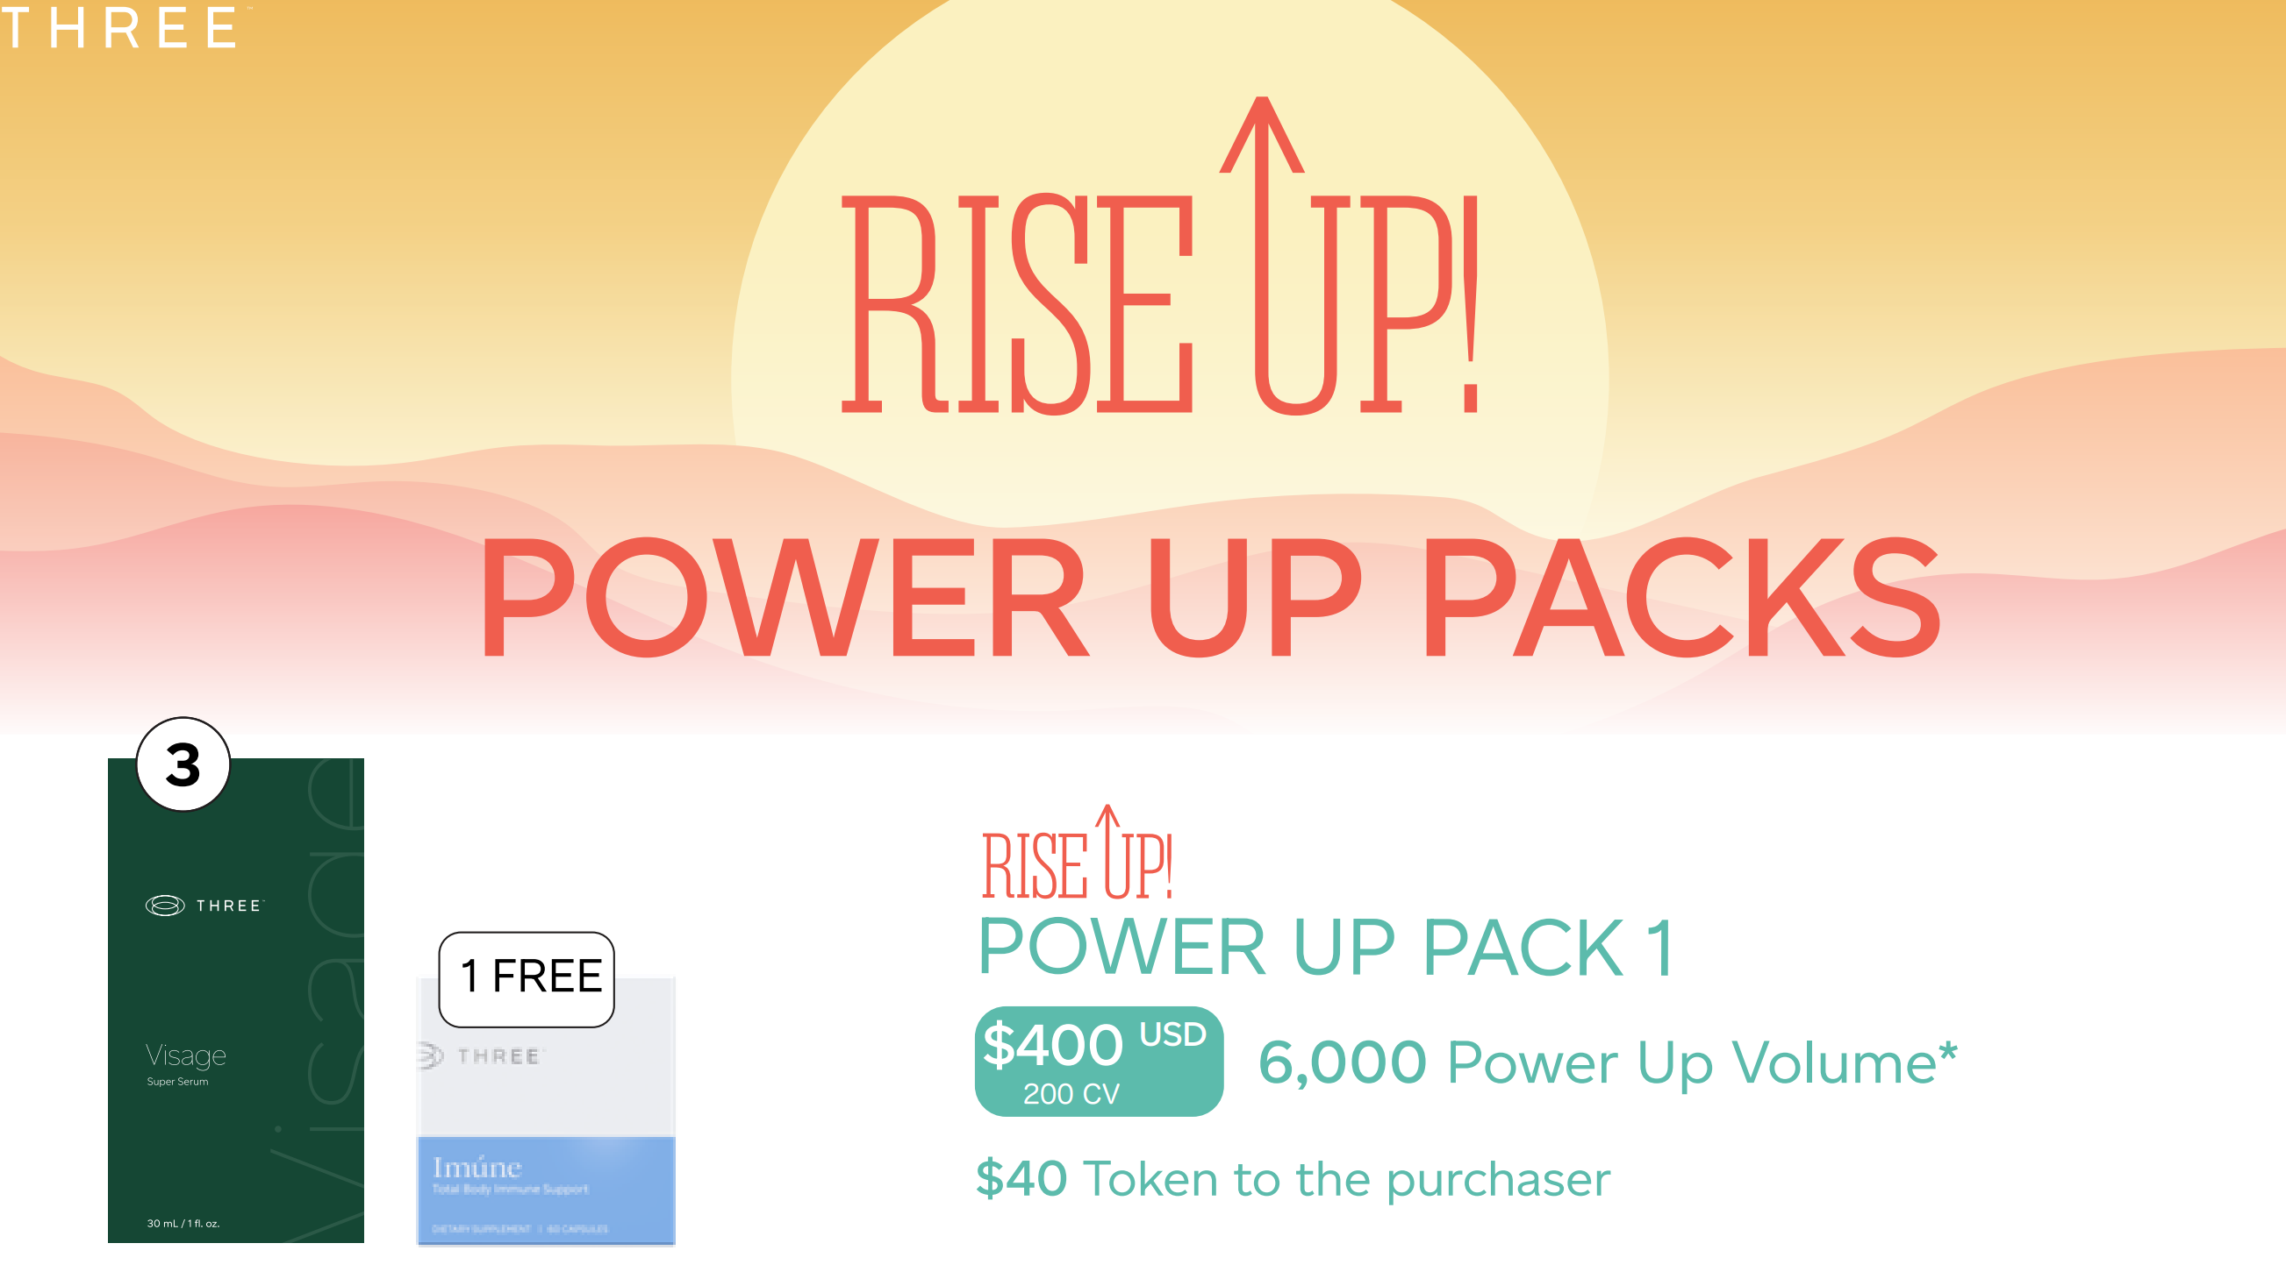

Slide 4
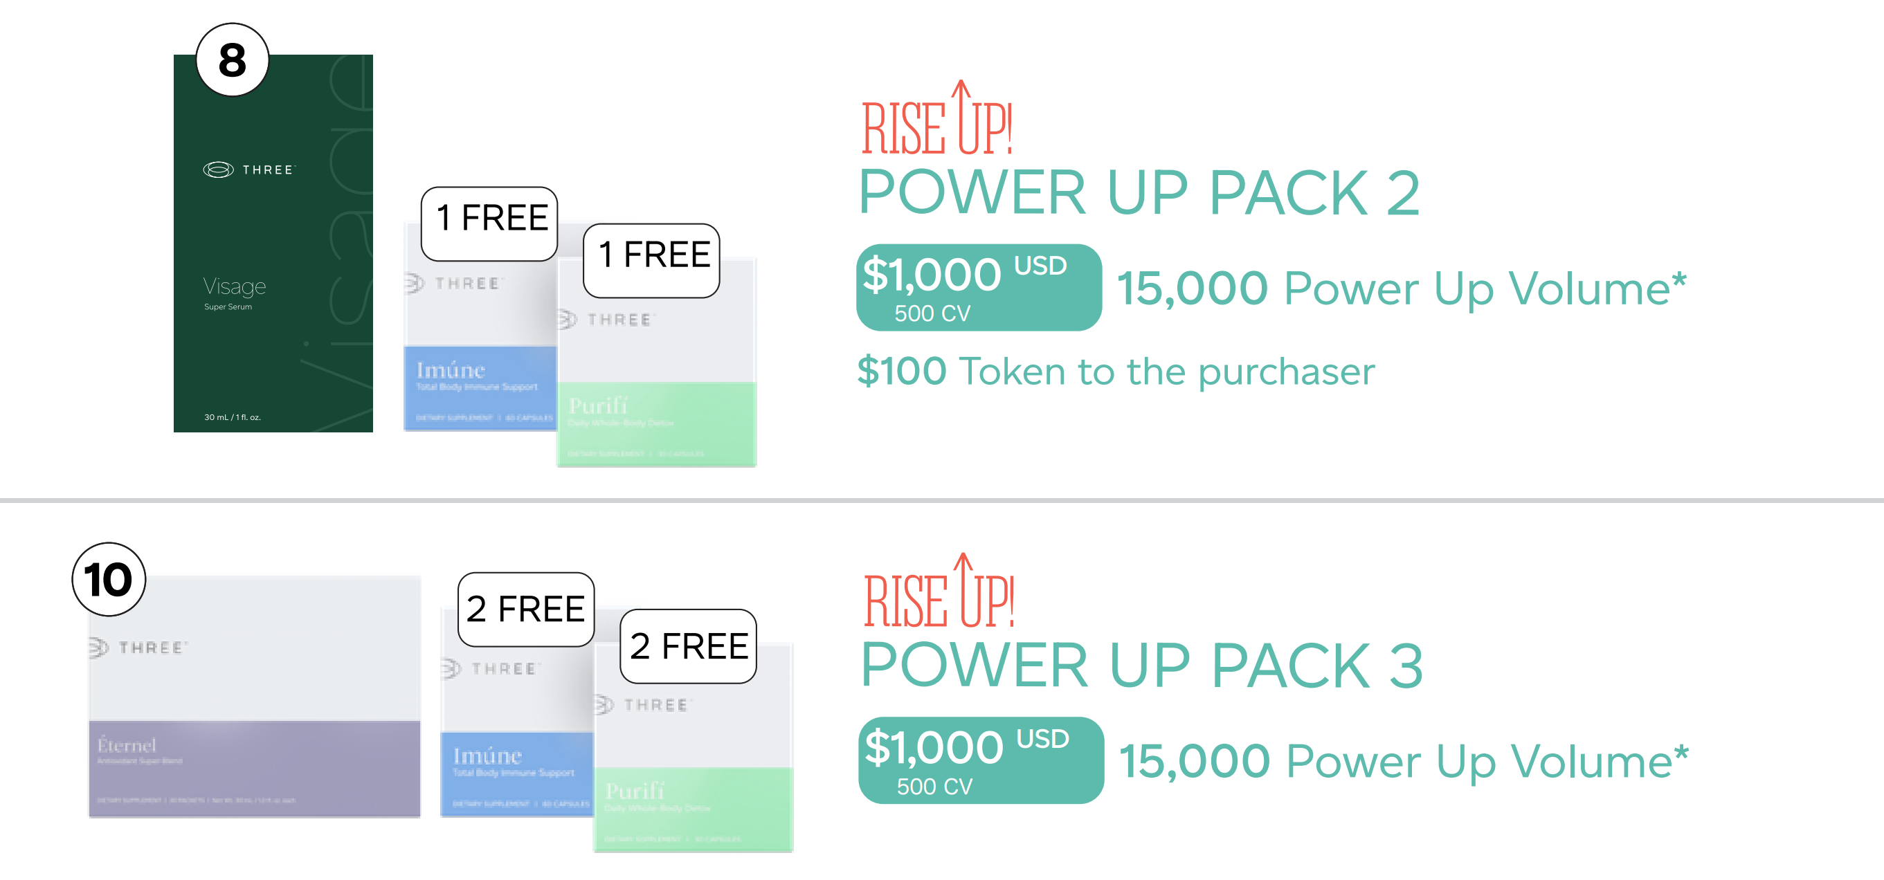

Slide 5
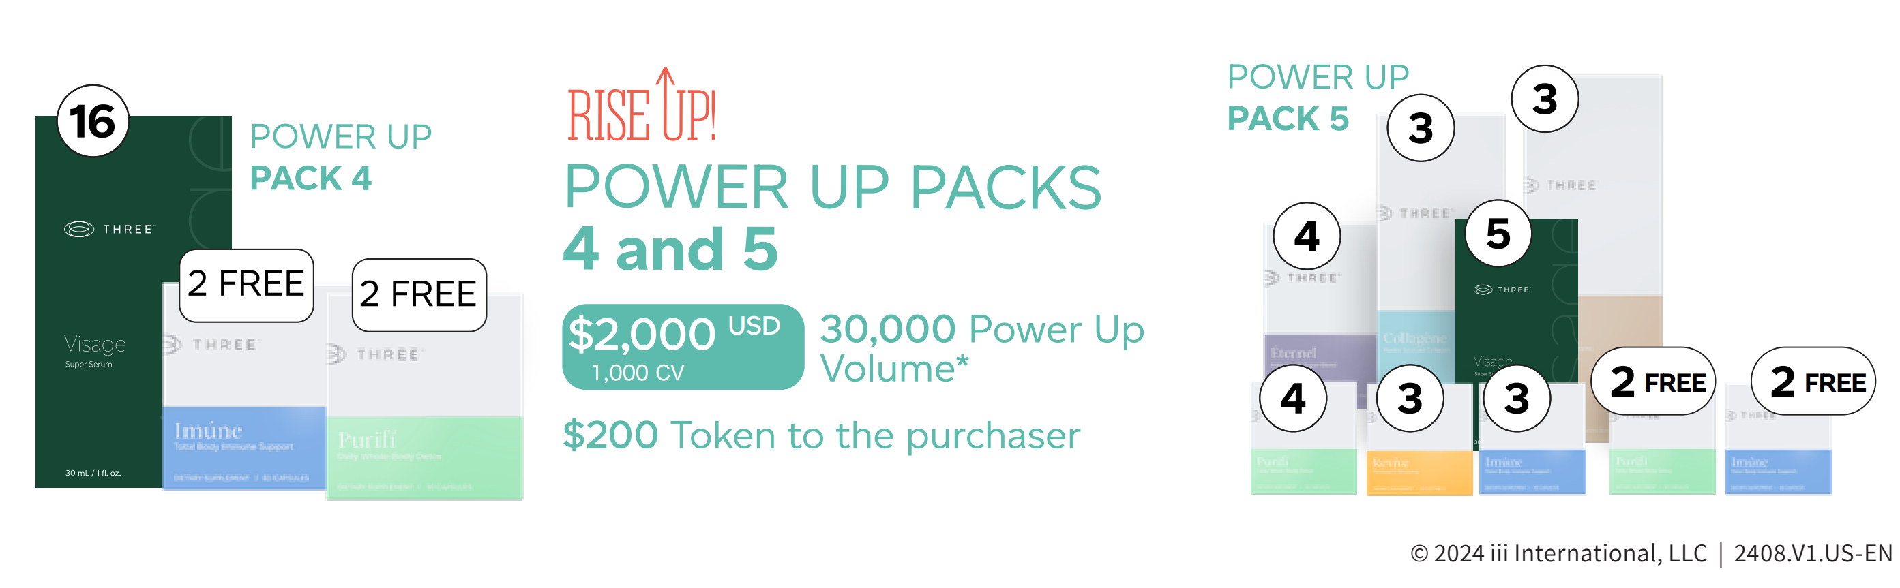

Slide 6
How Do Power Up Points Work?
1. Power Up Volume Points are “banked” on the “BIG” side of the purchaser. These power up points do not go upline.
(CV from purchase of Power Up Packages DO go upline.)
2. Power Up Points do NOT flush. You could go inactive, but the Power Up Points do not go away until the purchaser uses them to cycle.
3. Power Up Points will be used when the purchaser is creating volume on their lesser side but needs volume from their big side.
4. Power Up Points will apply the CV needed to create the cycle(s) and that volume will then be deducted from the Power Up Points.
POINTS
1.

Slide 7
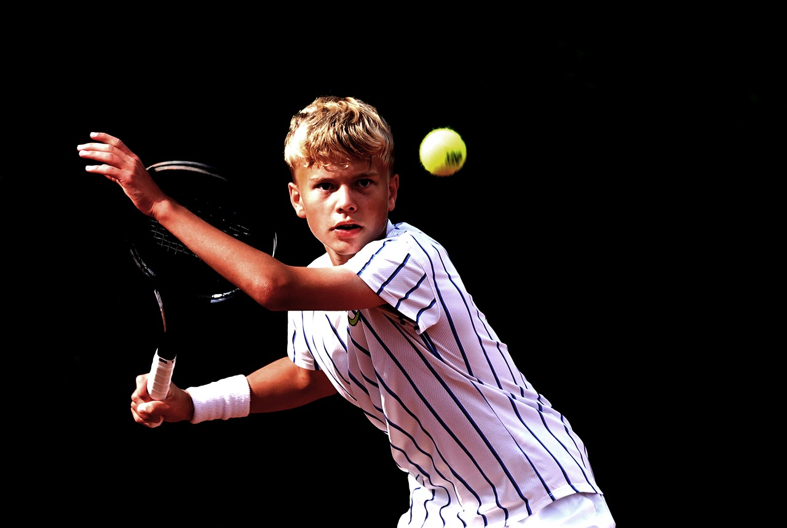
GAME PLAN
1.CHOOSE THE BIGGEST PACKAGE(S) YOU CAN
WITH THE POWER UP POINTS
(You must be a Brand Ambassador to be able to order the Power Up Pack)
2. IDENTIFY YOUR “BIG” SIDE
3. IDENTIFY ANY BUILDERS in YOUR GROUP
(They can do this too! YOU MAY OR NOT HAVE ANY YET)
*4. NOW WE WILL CONCENTRATE ON BUILDING YOUR “LESSER” SIDE! REFRESH YOUR PROSPECT LIST *
5. GET READY TO RUN ! ( PACKS AVAILABLE UNTIL SEPTEMBER 15)

Slide 8
YOU
YOUR “BIG” LEG
YOUR “LESSER” LEG
IMAGINE YOU HAVE 30,000 CV
POWER UP PACKS
X 2 = 60,000 CV
Placed on
“big” leg
HOW MANY CYCLES DOES THAT PREPARE YOU TO CREATE?
A cycle requires 600 (big) & 300 (lesser) CV
60,000 DIVIDED BY 600 = 100 CYCLES
YOU WILL CYCLE EVERY TIME THERE IS 300 CV ON YOUR LESSER SIDE*
PROFIT FROM CYCLES @ $35 = $3500.00
“ Happy 10” @ $45 = $4500.00
*Must be a
Qualified
Brand
Ambassador to
Earn cycles

Slide 9
YOU
EXAMPLE:
ENROLL 10 NEW PEOPLE ON LESSER SIDE
Examples of Volume from :
FOUNDERS 740 CV
(Now with Visage)
Power Up
Packages 200 CV
500 CV
1000 CV
Plus Existing Enrollment Packages
100 CV , 300 CV, 500 CV, 740 CV
VISAGE WILL BE A GAME CHANGER
300
THESE 10 ENROLLEES CREATED
4800 CV 16 CYCLES!
THAT IS 16 “300CV”
WE USE 16 “600CV” from the 60,000
YOUR PROFIT SO FAR IS
$560.00 ($35) CYCLE
OR $720.00 ($45) CYCLE
Big Leg
1000
600
200
300
60,000 CV
500
4800 CV
- 9600 CV
-4800 CV
1000
50,400 CV still left!
300
BUT NOW YOU
HAVE 10 NEW
BRAND AMBASSADORS
BUILDING !!
300
300
84 CYCLES LEFT TO GET =PROFIT $2940 (35) OR $3780 (45)

Slide 10
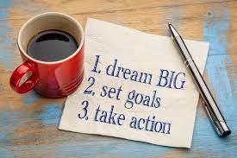
THIS IS LEVERAGE!
POWER UP POINTS
10 NEW ENROLLEES
CUTTING EDGE NEW PRODUCT
VISAGE
TIMING
STRATEGIZE WITH MENTOR ON RANK ADVANCING
EXCITEMENT
GAME ON!

